Slide 1
GST IMPACT-FINALISATION OF ACCOUNTS
18th May 2018|Trans Hindon Study Circle -Ghaziabad | Ashu Dalmia
www.gstindia.biz
1

Slide 2
Central point
Stake holder
Out Put Tax
Input Tax
Tax Payable
Management
Auditor
Revenue Authorities
www.gstindia.biz
2

Slide 3
Considerations
Statutory Requirements
Reconciliation
Accounting Entries
Retuns and Errors
Year End Adjustments
Transaction between distinct person
Accounting Standards
Accounts and Recods
www.gstindia.biz
3

Slide 4
Statutory Requirements
Section 35 (5) prescribes for audit in case turnover exceeds the prescribed limit.
Rule 80(3) provides limit of 2cr.
Section 44(2) provides to furnish,
annual return
copy of the audited annual accounts and
reconciliation statement, reconciling the value of supplies declared in the return furnished for the financial year with the audited annual financial statement,
and such other particulars as may be prescribed.
www.gstindia.biz
4

Slide 5
Reconciliations
Books of Account
Financial Statements
Records and Documents as per GST law
GST Returns
Other Returns viz. Income Tax
www.gstindia.biz
5

Slide 6
Books of Account
Separate Books for Each Registartion
Consolidated Books of Account
Specified Records to be maintained as per requirement of GST Law
Stock Transfer of Services like Stock Transfer of Goods
Cross charge or ISD or nothing
E-Ledgers
Inter Unit/Branch Transaction
www.gstindia.biz
6

Slide 7
GST Documents
Invoices
Bills of Supply
Delivery Challans
Credit Notes
Debit Notes
Refund Vouchers
Receipt Vouchers
Payment Vouchers
www.gstindia.biz
7

Slide 8
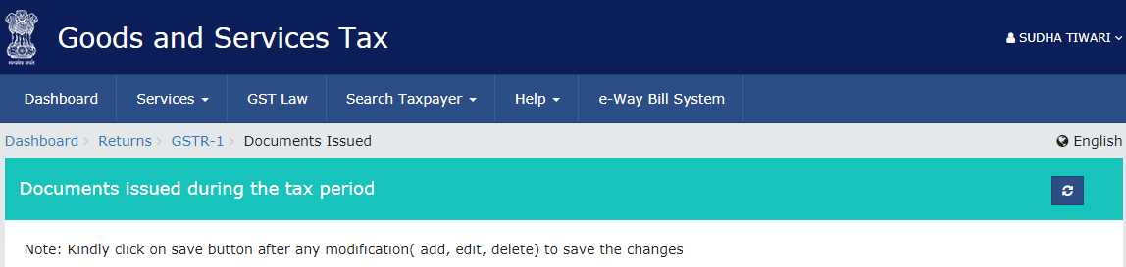
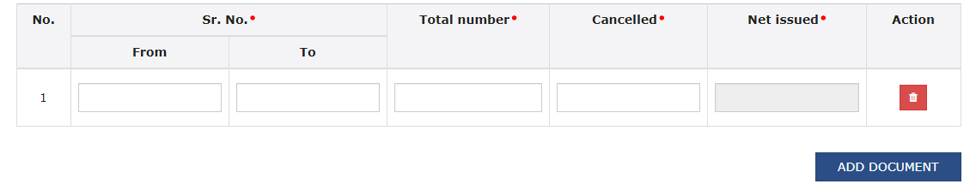
1. Invoices for outward supply
2. Invoices for inward supply from unregistered person
3. Revised Invoice
4. Debit Invoice
5. Credit Note
6. Receipt Voucher
7. Payment Voucher
8. Refund Voucher
9. Delivery Challan for Job work
10. Delivery challan for supply on approval
11. Delivery Challan in case of liquid gas
12. Delivery Challan in cases other than by way of supply (excluding at S. no. 9 to 11)
www.gstindia.biz
8

Slide 9
Electronic Credit Ledger
Electronic Liability Register
Electronic Cash Ledger
www.gstindia.biz
9

Slide 10
Electronic Credit Ledger
(FORM GST PMT-02)
Credit by
Every claim of input tax credit as self assessed in the return.
Re-credited to extent of rejection of Claimed Unutilized ITC
Debit by
Extent of discharge of any output liability
Claimed refund of any unutilized ITC
www.gstindia.biz
10

Slide 11
Electronic Cash Ledger
(FORM GST PMT-05)
Debit By
Payments towards tax, interest, penalty, fee or any other amount
Refund Claimed from Cash Ledger
Credit By
Amount deposited
TDS/ TCS claimed in FORM GSTR-02
Refund from Cash ledger rejected in FORM GST PMT-03 to the extent of rejection
www.gstindia.biz
11

Slide 12
Electronic Liability Ledger
(FORM GST PMT-01)
Debit by
Amount payable as per the return
Amount payable as determined by a proper officer
Credit by
Payment of every liability by a registered person as per his return
Payment of TDS, TCS, amount payable on RCM or in composition scheme, any amount paid
Amount of tax & interest payable as a result of mismatch
Any amount of demand reduced by AA or AT or court
Any amount of interest that may accrue from time to time
The amount of penalty imposed or liable to be imposed is reduced
www.gstindia.biz
12

Slide 13
Payment of every liability by a registered person as per his return shall be made by debiting the electronic credit ledger maintained as per rule 86 or the electronic cash ledger edger maintained as per rule 87 and the electronic liability register shall be credited accordingly.
Payment of tax
www.gstindia.biz
13

Slide 14
Accounting Heads-Current Asset-Tax Rate Wise
Input Ledgers
Input CGST A/c
Input CGST RCM A/c
Input CGST URD A/c
Electronic Credit CGST Ledger A/c
In Books:
Debit
On Portal:
Credit
Transfer to
Input Ledgers
Input SGST A/c
Input SGST RCM A/c
Input SGST URD A/c
Electronic Credit SGST Ledger A/c
In Books:
Debit
On Portal:
Credit
Transfer to
www.gstindia.biz
14

Slide 15
Accounting Heads-Current Asset-Tax Rate Wise
Input Ledgers
Input IGST A/c
Input IGST RCM A/c
Input IGST URD A/c
Electronic Credit IGST Ledger A/c
In Books:
Debit
On Portal:
Credit
Transfer to
www.gstindia.biz
15

Slide 16
Accounting Heads-Current Liabilities-Tax Rate Wise
Input Ledgers
Output CGST A/c
Output CGST (Advance) A/c
Output CGST URD A/c
Output CGST RCM A/c
CGST Liability Register
In Books:
Credit
On Portal:
Debit
Transfer to
Output SGST A/c
Output SGST (Advance) A/c
Input Ledgers
Output SGST URD A/c
Output SGST RCM A/c
SGST Liability Register
In Books:
Credit
On Portal:
Debit
Transfer to
www.gstindia.biz
16

Slide 17
Accounting Heads-Current Liabilities-Tax Rate Wise
Input Ledgers
Output IGST A/c
Output IGST (Advance) A/c
Output IGST URD A/c
Output IGST RCM A/c
IGST Liability Register
In Books:
Credit
On Portal:
Debit
Transfer to
www.gstindia.biz
17

Slide 18
Accounting Heads-Payments
Cash/ Bank A/c
Electronic Cash CGST Ledger A/c
Electronic Cash SGST Ledger A/c
Electronic Cash IGST Ledger A/c
In Books:
Debit
On Portal:
Credit
Transfer to
www.gstindia.biz
18

Slide 19
Accounting Heads-Set Off
CGST Liability Register
SGST Liability Register
IGST Liability Register
Electronic Credit CGST Ledger A/c
Electronic Credit SGST Ledger A/c
Electronic Credit IGST Ledger A/c
Electronic Cash CGST Ledger A/c
Electronic Cash SGST Ledger A/c
Electronic Cash IGST Ledger A/c
Set Off with
In Books:
Debit
On Portal:
Credit
In Books:
Credit
On Portal:
Debit
www.gstindia.biz
19

Slide 20
IGST Refund Entries (Export on Payment of Tax)
Particulars | IGST | SGST | CGST
For Refund filing For Goods: At the time of filing GSTR-1 For Services: At the time of filing Form RFD-01A | IGST Refund Receivable A/c Dr. To Electronic Credit IGST Ledger A/c | SGST Refund Receivable A/c Dr. To Electronic Credit SGST Ledger A/c | CGST Refund Receivable A/c Dr. To Electronic Credit CGST Ledger A/c
For receipt of Refund | Bank A/c Dr. To IGST Refund Receivable A/c | Bank A/c Dr. To SGST Refund Receivable A/c | Bank A/c Dr. To CGST Refund Receivable A/c
For rejection of refund, if any | Electronic Credit IGST Ledger A/c Dr. To IGST Refund Receivable A/c | Electronic Credit SGST Ledger A/c Dr. To SGST Refund Receivable A/c | Electronic Credit CGST Ledger A/c Dr. To CGST Refund Receivable A/c
For appeal filed against rejection order | IGST Refund Receivable A/c Dr. To Electronic Credit IGST Ledger A/c | SGST Refund Receivable A/c Dr. To Electronic Credit SGST Ledger A/c | CGST Refund Receivable A/c Dr. To Electronic Credit CGST Ledger A/c
www.gstindia.biz
20

Slide 21
GST Returns (Few)
GSTR 3B
GSTR 1
RFD 01
ITC 04
www.gstindia.biz
21

Slide 22
Reconciliation between 3B,GSTR 1 and Books of Accounts
www.gstindia.biz
22

Slide 23
Matching of Out ward Supply 3B vs. GSTR 1
Matching of Input tax 3B vs 2A
www.gstindia.biz
23

Slide 24
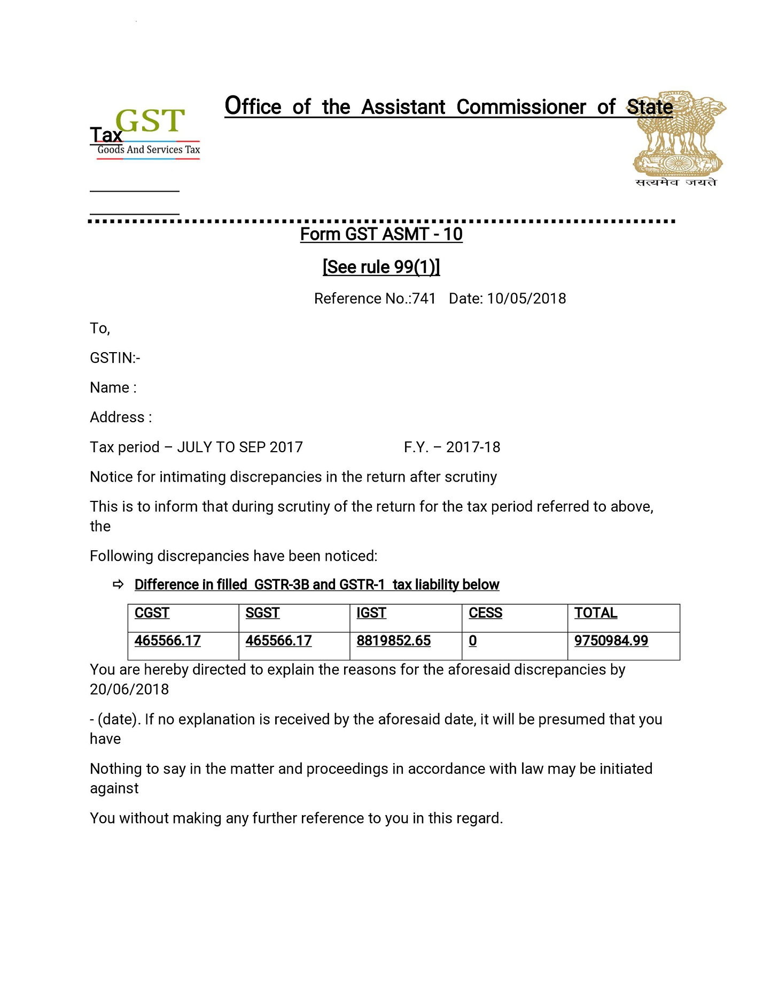
Section 61 of the CGST and corresponding SGST/UGST Act and Rule 99:
Proper officer empowered to scrutinize returns and its correctness
Notice in ASMT-10
Reply by registered person in ASMT-11
If staisfied order in ASMT-12 other wise possibility of action u/s 65,66,67,73,74
www.gstindia.biz
24

Slide 25
TABLES OF GSTR-3B
Table No. | Description
3.1 (a) | Outward taxable supplies (other than zero rated, nil rated and exempted)
3.1 (b) | Outward taxable supplies (zero rated )
3.1 (c) | Other outward supplies (Nil rated, exempted)
3.1 (d) | Inward supplies (liable to reverse charge)
3.1 (e) | Non-GST outward supplies
4 (A) (1) | Import of goods
4 (A) (2) | Import of services
4 (A) (3) | Inward supplies liable to reverse charge (other than 1 & 2 above)
4 (A) (4) | Inward supplies from ISD
4 (A) (5) | All other ITC
4 (B) | ITC Reversed
4 (D) | Ineligible ITC
www.gstindia.biz
25

Slide 26
TABLES OF GSTR-1
Table No. | Description
4 | Taxable outward supplies made to registered persons (including UIN-holders) other than supplies covered by Table 6
5 | Taxable outward inter-State supplies to un-registered persons where the invoice value is more than Rs 2.5 lakh
7 | Taxable supplies (Net of debit notes and credit notes) to unregistered persons other than the supplies covered in Table 5
9 | Amendments to taxable outward supply details furnished in returns for earlier tax periods in Table 4, 5 and 6 [including debit notes, credit notes, refund vouchers issued during current period and amendments thereof]
11 | Consolidated Statement of Advances Received/Advance adjusted in the current tax period/ Amendments of information furnished in earlier tax period
www.gstindia.biz
26

Slide 27
TABLES OF GSTR-1
Table No. | Description
6A | Exports
6B | Supplies made to SEZ unit or SEZ Developer
6C | Deemed exports
8A | Inter-State supplies to registered persons
8B | Intra- State supplies to registered persons
8C | Inter-State supplies to unregistered persons
8D | Intra-State supplies to unregistered persons
www.gstindia.biz
27

Slide 28
MATCHING OF ELIGIBLE ITC
GSTR-3B (Table 4)
A(1), A(2) & A(3)
A (4)
GSTR-3B (Table 3.1)
(d)
Other Returns
N.A.
2A of ISD
A (5)
(B) & (D)
N.A.
N.A.
N.A.
N.A.
ICEGATE
N.A.
Table 4A(1) & (2) should match with ICEGATE Data
www.gstindia.biz
28

Slide 29
MATCHING OF DETAILS OF OUTWARD SUPPLIES OF GOODS OR SERVICES
GSTR-3B (Table 3.1)
(a)
(b)
GSTR-3B (Table 4)
N.A.
GSTR-1 (Table)
4, 5, 7, 9 & 11
6A, 6B & 6C
(c) & (e)
(d)
N.A.
A (1), A(2) & A(3)
8A, 8B, 8C & 8D
N.A.
ICEGATE
(for refund) of IGST)
N.A.
Table 3.1 (b) of GSTR-3B and Table 6A, 6B & 6C of GSTR-1
www.gstindia.biz
29

Slide 30

Circular No. 26/2017 dated 29th Dec 2017
How to Correct errors as Revision is not permissible
www.gstindia.biz
30

Slide 31
Type of Transaction | Scenario No. | Particulars
Forward Charge Mechanism | 1 | Taxable Value and Corresponding Taxes was over reported
 | 2 | Only Taxes was over reported
 | 3 | Taxes paid under wrong head (CGST and SGST instead of IGST)
 | 4 | Taxable Value and Corresponding Taxes was over reported
 | 5 | Only Taxes was under reported
Export Supplies | 6 | Export supplies not reported in GSTR-3B
 | 7 | Export supplies under reported in GSTR-3B
 | 8 | Export supplies over reported in GSTR-3B
Input Tax Credit (ITC) | 9 | Over reported ITC in GSTR-3B
 | 10 | Under reported ITC in GSTR-3B
Reverse Charge Mechanism | 11 | Taxable Value and Corresponding Taxes was over reported
 | 12 | Only Taxes was over reported
 | 13 | Taxes paid under wrong head (CGST and SGST instead of IGST)
 | 14 | Taxable Value and Corresponding Taxes was over reported
 | 15 | Only Taxes was under reported
www.gstindia.biz
31

Slide 32
Scenario-1: FCM-Taxable value and corresponding taxes was over reported
Company X has filed their return for the month of Apr’18 with over reported taxable value Rs.5,00,000/- and corresponding taxes i.e CGST & SGST Rs.45,000/- each instead of taxable value Rs. 50,000/- and corresponding taxes i.e CGST & SGST Rs.4,500/- each. What can they do in current period return or in next period return?
In this case
Company X will adjust its difference taxable value and tax liability in the return of next month i. e May’18 or refund may be claimed where adjustment is not feasible.
Taxable value will be reduced or adjusted by Rs.4,50,000/- and taxes i.e. CGST & SGST will be Reduced by Rs. 40,500/- each.
www.gstindia.biz
32

Slide 33
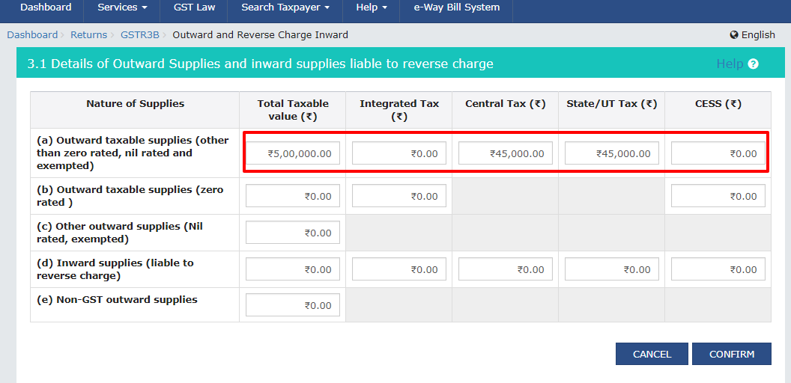
Reported – Apr’ 2018
Scenario-1
www.gstindia.biz
33

Slide 34
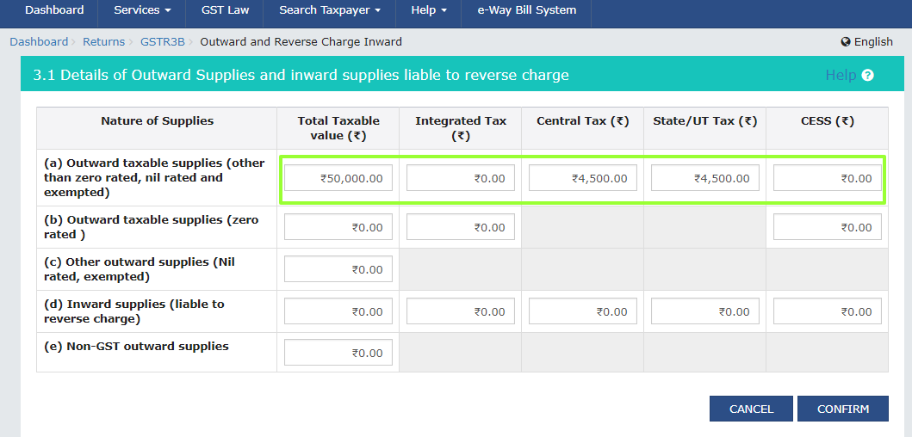
Scenario-1
Actual – Apr’ 2018
www.gstindia.biz
34

Slide 35
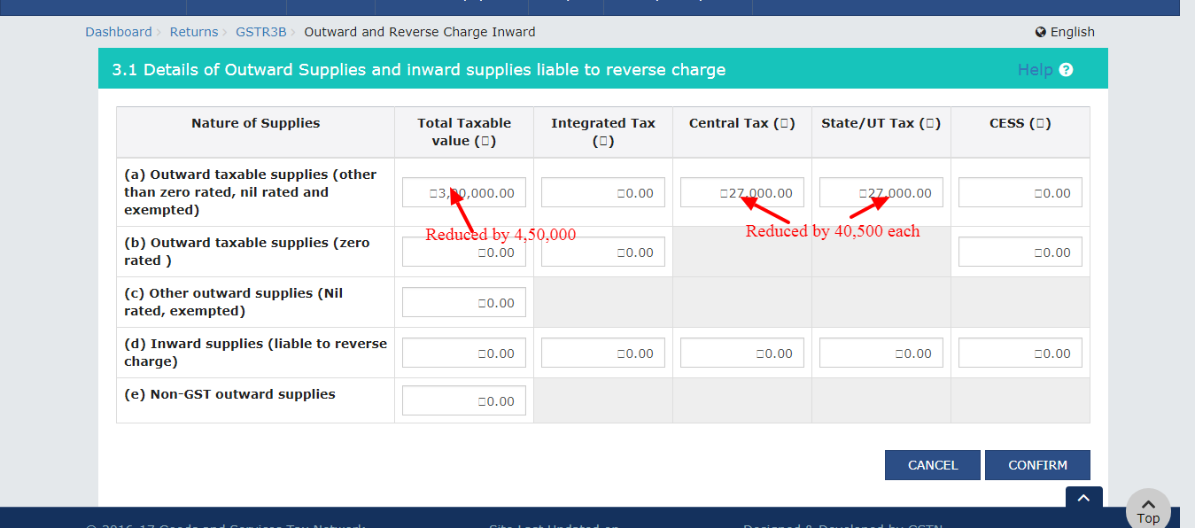
Report in May’18 corresponding to Apr’18 (If data available
in May’ 2018 otherwise there will be no adjustment)
Scenario-1
May'18 Actual | 7,50,000
Less for adjustment-Apr'18 | (4,50,000)
May'18 Reported | 3,00,000
May'18 Actual | 6,75,00 | 67500
Less for adjustment-Apr'18 | (40,500) | (40,500)
May'18 Reported | 27,000 | 27,000
www.gstindia.biz
35

Slide 36
Scenario-2 : FCM-Only taxes was over reported
Company X has filed their return for the month of Apr’18 with taxes i.e CGST & SGST Rs. 45,000/- each instead of taxes i.e CGST & SGST Rs. 30,000/- each. What can they do in current period return or in next period return?
In this case
Company X will adjust its difference tax liability in the return of next month i.e. May’18 or refund may be claimed where adjustment is not feasible.
Taxes i.e. CGST & SGST will be Reduced by Rs. 15,000/- each.
www.gstindia.biz
36

Slide 37
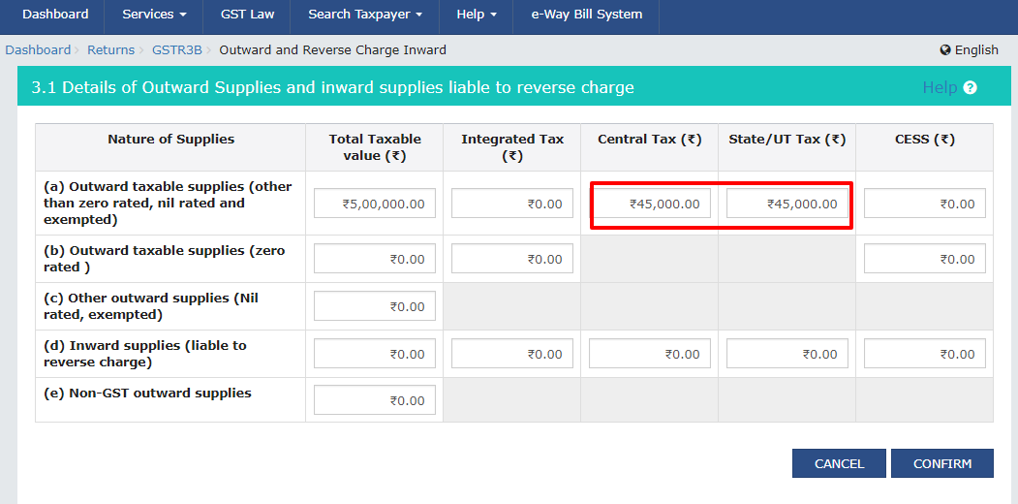
Reported – Apr’ 2018
Scenario-2
www.gstindia.biz
37

Slide 38
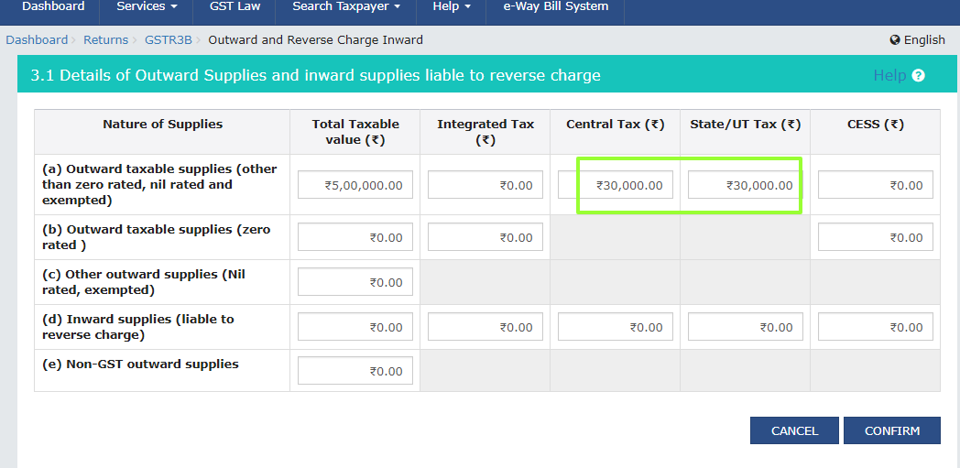
Actual – Apr’ 2018
Scenario-2
www.gstindia.biz
38

Slide 39
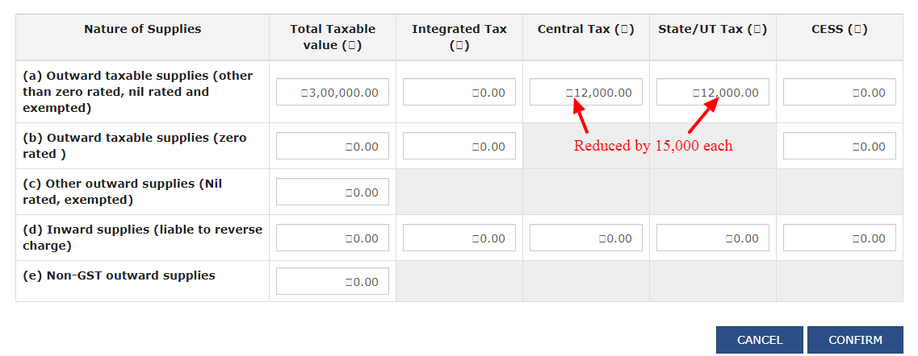
Report in May’18 corresponding to Apr’18 (If data available in
May’ 2018 otherwise there will be no adjustment)
Scenario-2
May'18 Actual | 27,000 | 27,000
Less for adjustment-Apr'18 | (15,000) | (15,000)
May'18 Reported | 12,000 | 12,000
www.gstindia.biz
39

Slide 40
Scenario-3 : FCM-Paid under wrong head
Company X has filed their return for the month of Apr’18, After submission of the return the company realise that they had shown intra state supply as inter state supply with taxes i.e CGST & SGST Rs. 45,000/- each instead of tax i.e IGST of Rs. 90,000/- . What can they do in current period return or in next period return??
In this case
Company’s IGST liability will be increased by Rs 90,000/- and amount wrongly entered in CGST and SGST will either be adjusted or claim as refund in the return of next month i. e May’18.
CGST and SGST will be claim as refund.
Such reported liability will be subject to interest u/s 50.
www.gstindia.biz
40

Slide 41
Reported – Apr’ 2018
Scenario-3
www.gstindia.biz
41

Slide 42
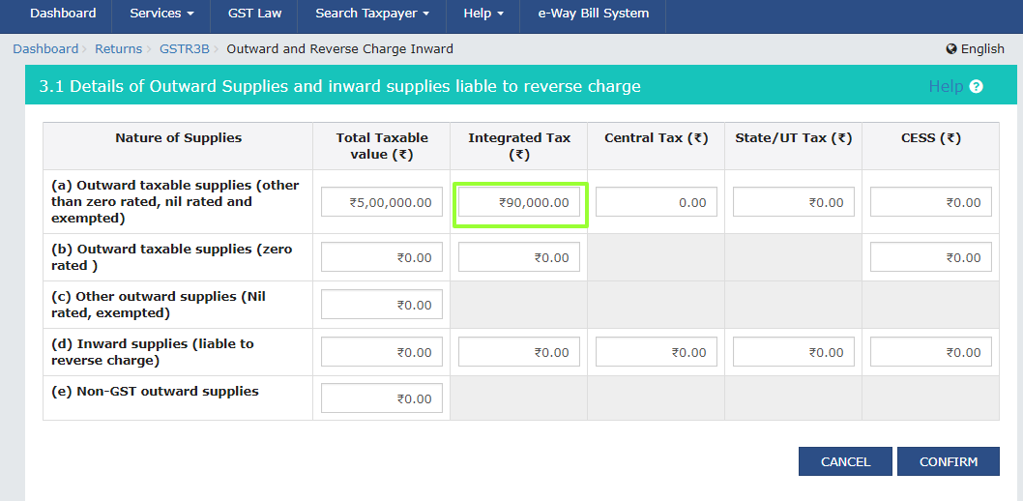
Scenario-3
Actual – Apr’ 2018
www.gstindia.biz
42

Slide 43
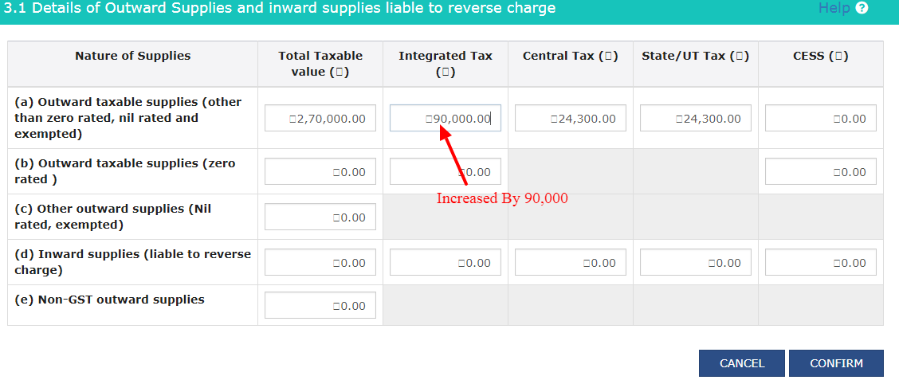
Scenario-3
Report in May’18 corresponding to Apr’18 (If sufficient data
available in May’ 2018 otherwise there will be no adjustment)
Reported IGST will be subject to interest u/s 50
 | Taxable Value | IGST | CGST | SGST
May'18 Actual | 270000 |  | 24300 | 24300
Add liability -Apr'18 |  | 90000
May'18 Reported | 270000 |  | 24300 | 24300
Wrongly reported CGST and SGST in Apr’18 will be claimed as refund.
www.gstindia.biz
43

Slide 44
Scenario-4: FCM-Taxable value and corresponding taxes was under reported
Company X has filed their return for the month of Apr’18 with under reported taxable value Rs. 4,00,000/- and corresponding taxes i.e CGST & SGST Rs. 36,000/- each instead of taxable value Rs. 5,00,000/- and corresponding taxes i.e CGST & SGST Rs. 45,000/- each. What can they do in current period return or in next period return?
In this case
Company X will increased its taxable value and tax liability by under reported taxable value and tax liability in the return of next month i.e. May’18.
Taxable value will be Increased by Rs.1,00,000/- and taxes i.e. CGST & SGST will be increased by Rs. 9000/- each.
Such under reported liability will be subject to interest u/s 50.
www.gstindia.biz
44

Slide 45
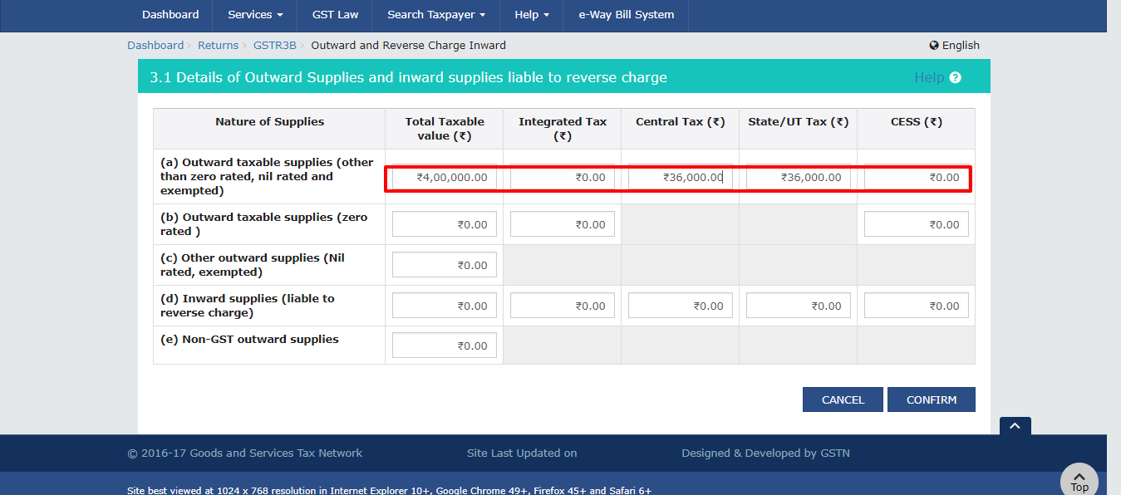
Reported – Apr’ 2018
Scenario-4
www.gstindia.biz
45

Slide 46
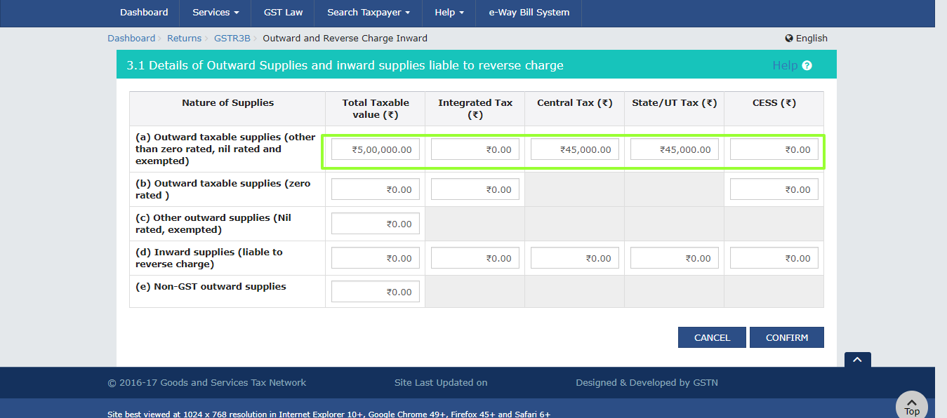
Actual – Apr’ 2018
Scenario-4
www.gstindia.biz
46

Slide 47
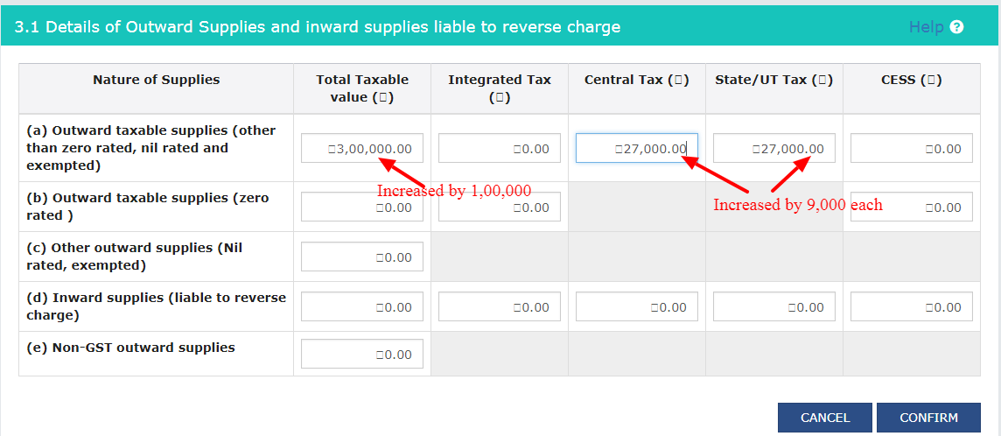
Scenario-4
Report in May’18 corresponding to Apr’18
May'18 Actual | 200000
Add Liability-Apr'18 | 100000
May'18 Reported | 300000
May'18 Actual | 18000 | 18000
Add Liability-Apr'18 | 9000 | 9000
May'18 Reported | 27000 | 27000
www.gstindia.biz
47

Slide 48
Scenario-5 : FCM-Only taxes was under reported
Company X has filed their return for the month of Apr’18 with taxes i.e CGST & SGST Rs. 35,000/- each instead of taxes i.e. CGST & SGST Rs. 36,000/- each. What can they do in current period return or in next period return?
In this case
Company X will increase its tax liability by the under reported taxes in the return of next month i.e. May’18.
Taxes i.e. CGST & SGST will be Reduced increased by Rs. 1000/- each.
Such under reported liability will be subject to interest u/s 50
www.gstindia.biz
48

Slide 49
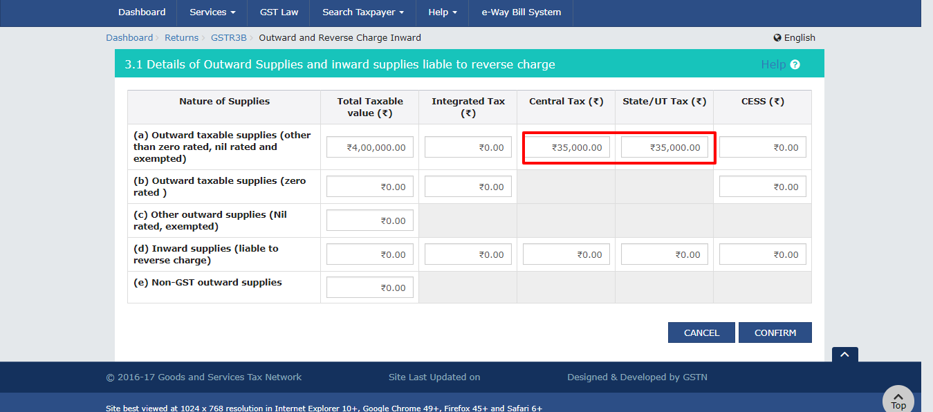
Reported – Apr’ 2018
Scenario-5
www.gstindia.biz
49

Slide 50
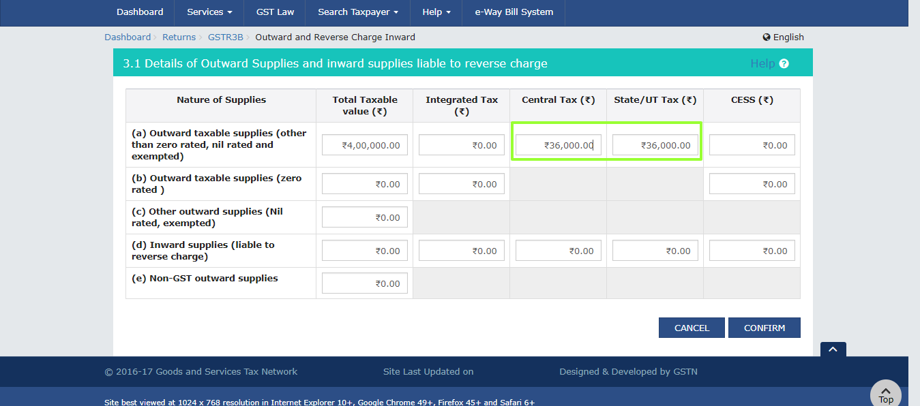
Actual – Apr’ 2018
Scenario-5
www.gstindia.biz
50

Slide 51
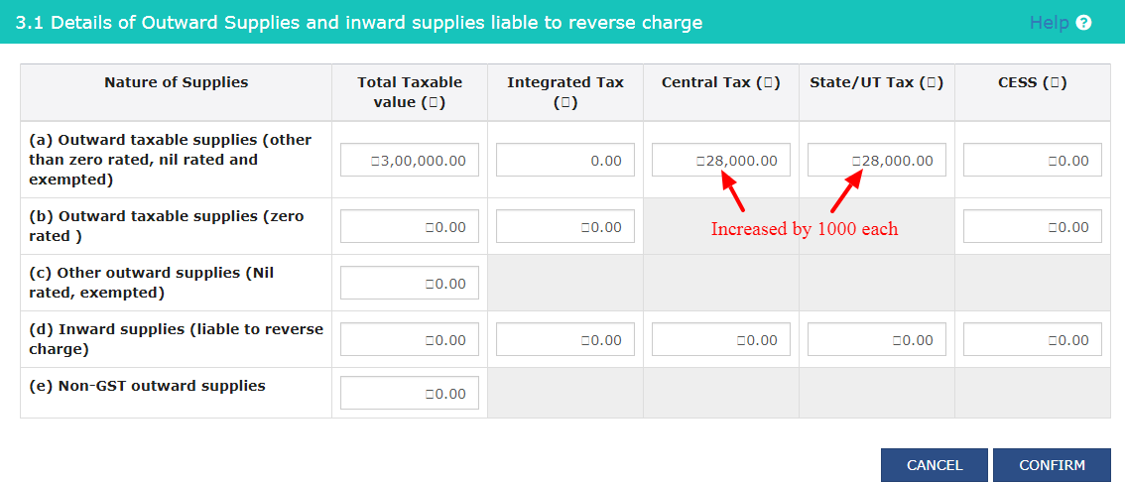
Scenario-5
Report in May’18 corresponding to Apr’18
May'18 Actual | 27,000 | 27,000
Add Liability-Apr'18 | 1,000 | 1,000
May'18 Reported | 28,000 | 28,000
www.gstindia.biz
51

Slide 52
Scenario-6 : Export Supplies not reported in GSTR 3B
Company X has filed their return for the month of Apr’18 at the time of reconciliation with GSTR1 the company realise that they had shown zero rated outward taxable supply as NIL . What can they do in current period return or in next period return?
In this case
Company will be report both taxable value and IGST amount in the return of next month i. e May’18.
Interest payable on not reported liability shall be applicable.
www.gstindia.biz
52

Slide 53
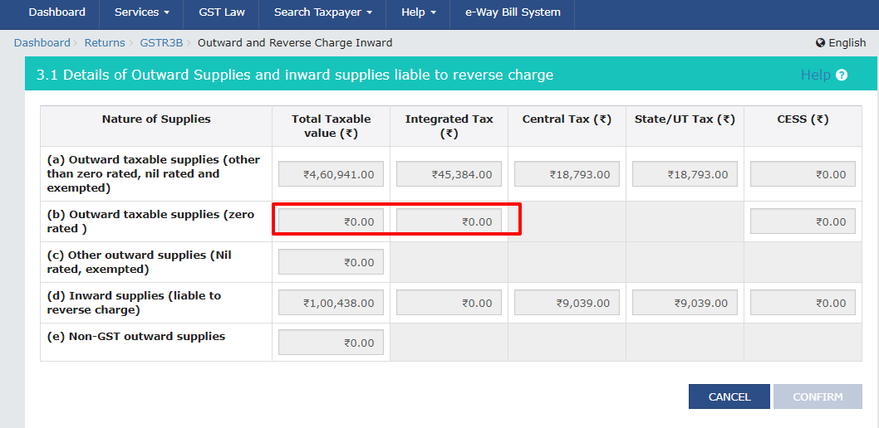
Reported – Apr’ 2018
Scenario-6
www.gstindia.biz
53

Slide 54
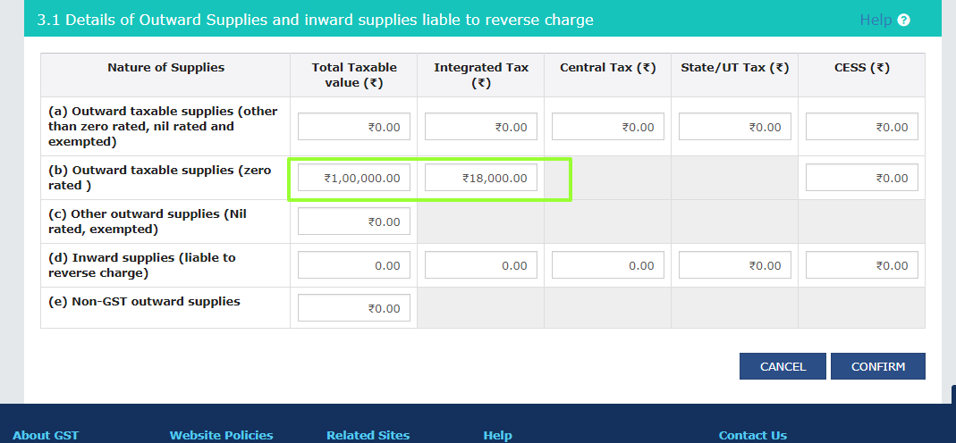
Actual – Apr’ 2018
Scenario-6
www.gstindia.biz
54

Slide 55
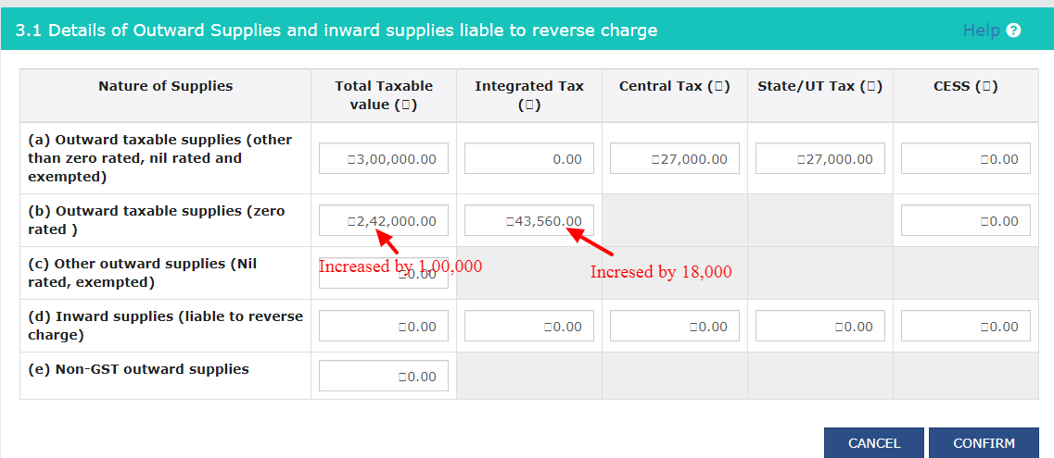
Scenario-6
Report in May’18 corresponding to Apr’18
May'18 Actual | 1,42,000
Add -Apr'18 | 1,00,000
May'18 Reported | 2,42,000
May'18 Actual | 2,55,60
Add liability-Apr'18 | 1,80,00
May'18 Reported | 43,560
www.gstindia.biz
55

Slide 56
Scenario-7 : Export Supplies under reported in GSTR 3B
Company X has filed their return for the month of Apr’18,at the time of reconciliation with GSTR1 the company realise that they had shown zero rated outward taxable supply as under reported taxable value Rs.10,000/- and corresponding taxes i.e IGST Rs.18,00/- instead of taxable value Rs. 100,000/- and corresponding taxes i.e IGST Rs.18,000/- . What can they do in current period return or in next period return?
In this case
Company will increase its both taxable value and tax amount subsequent month i.e. May’18.
Taxable value will be increased by Rs 90,000 and IGST amount by Rs 16,200.
Interest payable on under reported liability shall be applicable.
www.gstindia.biz
56

Slide 57
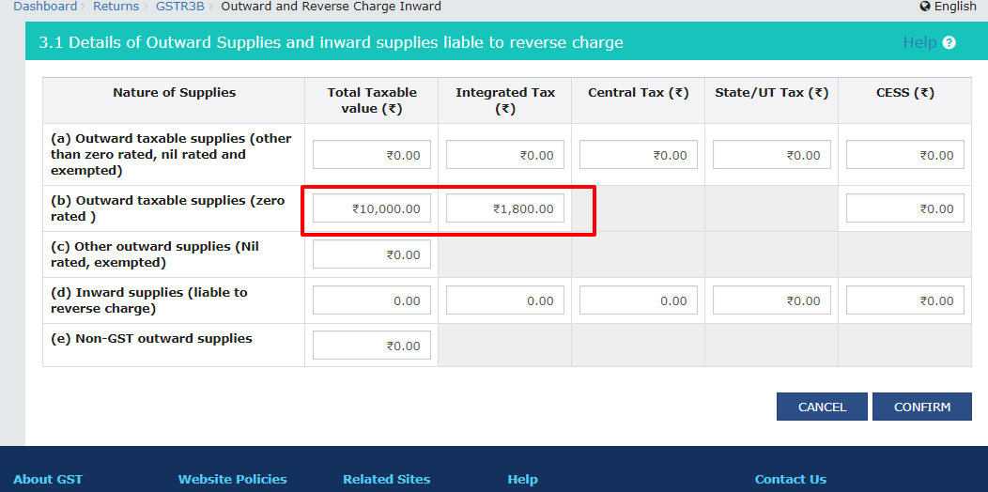
Reported – Apr’ 2018
Scenario-7
www.gstindia.biz
57

Slide 58
Actual – Apr’ 2018
Scenario-7
www.gstindia.biz
58

Slide 59
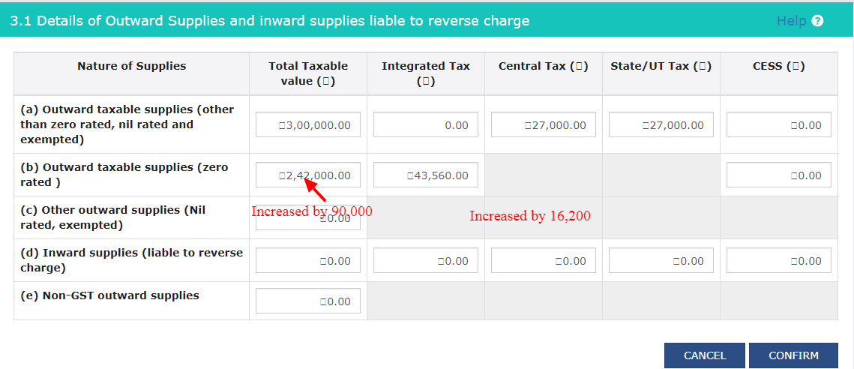
Scenario-7
Report in May’18 corresponding to Apr’18
May'18 Actual | 1,52,000
Add -Apr'18 | 90,000
May'18 Reported | 2,42,000
May'18 Actual | 27,360
Add liability-Apr'18 | 16,200
May'18 Reported | 43,560
www.gstindia.biz
59

Slide 60
Scenario-8 : Export Supplies over-reported in GSTR 3B
Company X has filed their return for the month of Apr’18, after the return the company realise that they had shown zero rated outward taxable supply as over reported taxable value Rs.2,00,000/- and corresponding taxes i.e IGST Rs.36,000/- instead of taxable value Rs. 100,000/- and corresponding taxes i.e IGST Rs.18,000/-. What can they do in current period return or in next period return?
In this case
Firstly, Company will adjust such over reported Taxable value and tax lability in the next month against export supplies.
If there is no data of export supplies available in the next month, then company should be reduce that over reported export amount from Domestic Taxable value & Tax amount i.e. IGST in subsequent month i.e. May’18.
Taxable value of Domestic supply will be reduced by Rs 1,00,000 and IGST amount by Rs 18000.
Interest payable on under reported liability
www.gstindia.biz
60

Slide 61
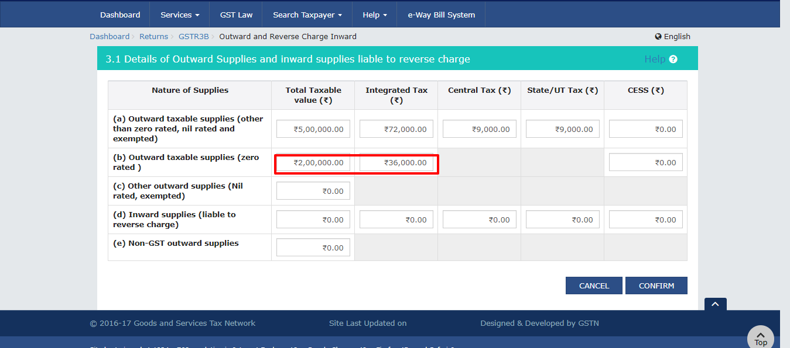
Reported – Apr’ 2018
Scenario-8
www.gstindia.biz
61

Slide 62
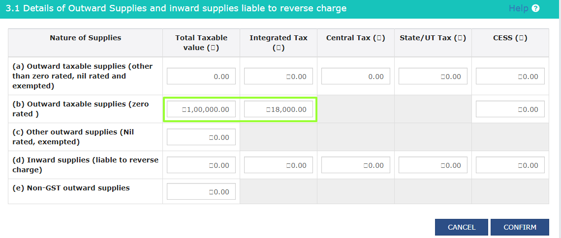
Actual – Apr’ 2018
Scenario-8
www.gstindia.biz
62

Slide 63
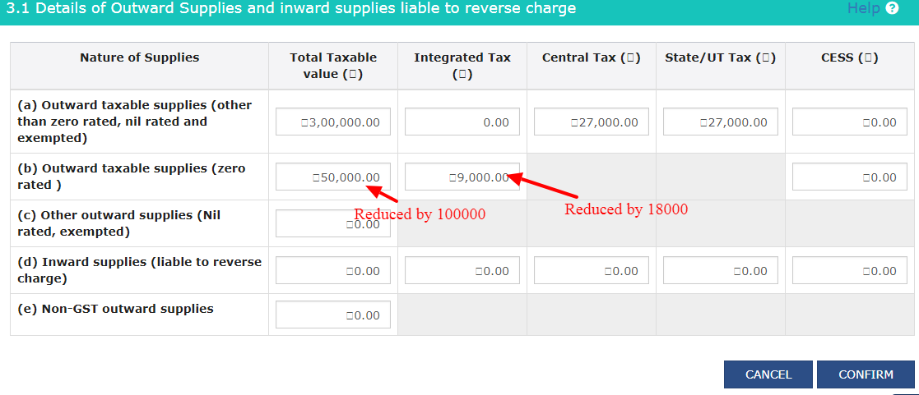
Scenario-8
Report in May’18 corresponding to Apr’18
May'18 Actual | 1,50,000
Less for adjustment-Apr'18 | 1,00,000
May'18 Reported | 50,000
May'18 Actual | 27,000
Less for adjustment -Apr'18 | 18,000
May'18 Reported | 9,000
www.gstindia.biz
63

Slide 64
Scenario-9 : Over reported ITC in GSTR 3B
Company X has filed their return for the month of Apr’18. After the return the company realise that ITC claimed as over reported taxes i.e IGST Rs.10,000/- ,CGST & SGST Rs, 3,000/- each instead of taxes i.e IGST Rs.5,000/- ,CGST & SGST Rs, 2,000/- each . What can they do?
In this case
Company will pay over reported liability which will be payable through debit in Electronic cash Ledger along with interest.
Over reported GST ITC should be reversed from its respective head, i.e. CGST ITC will only be reversed from CGST ITC.
Interest payable on under reported liability
www.gstindia.biz
64

Slide 65
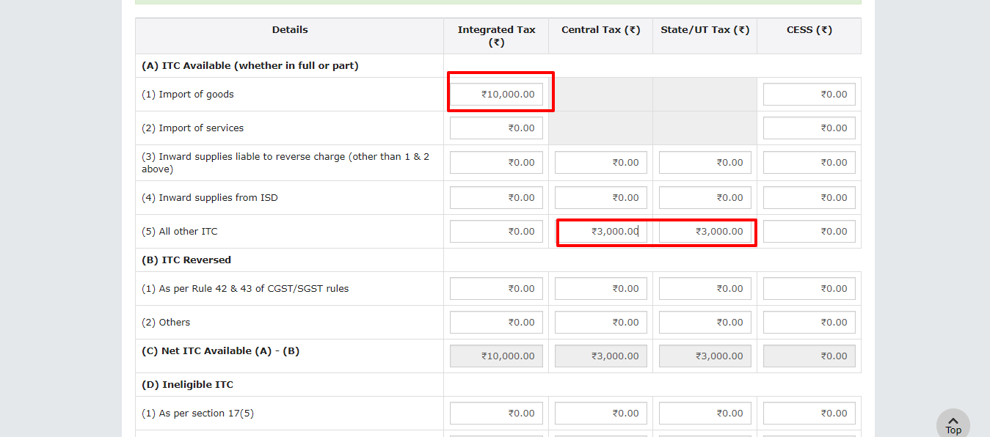
Reported – Apr’ 2018
Scenario-9
www.gstindia.biz
65

Slide 66
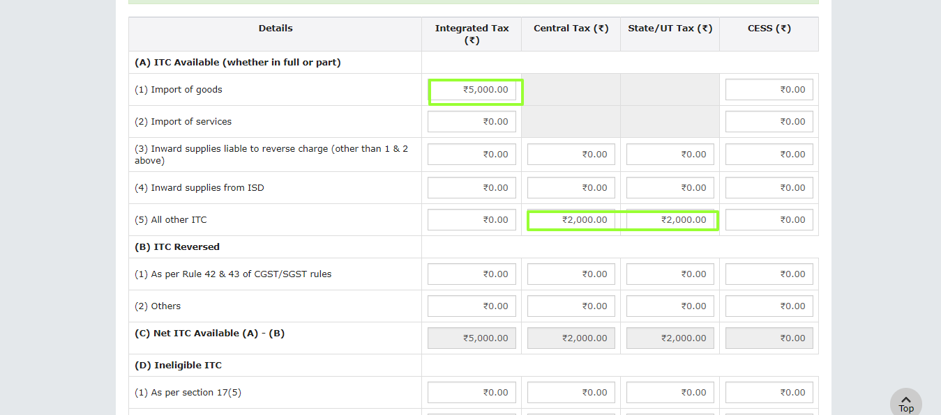
Actual – Apr’ 2018
Scenario-9
www.gstindia.biz
66

Slide 67
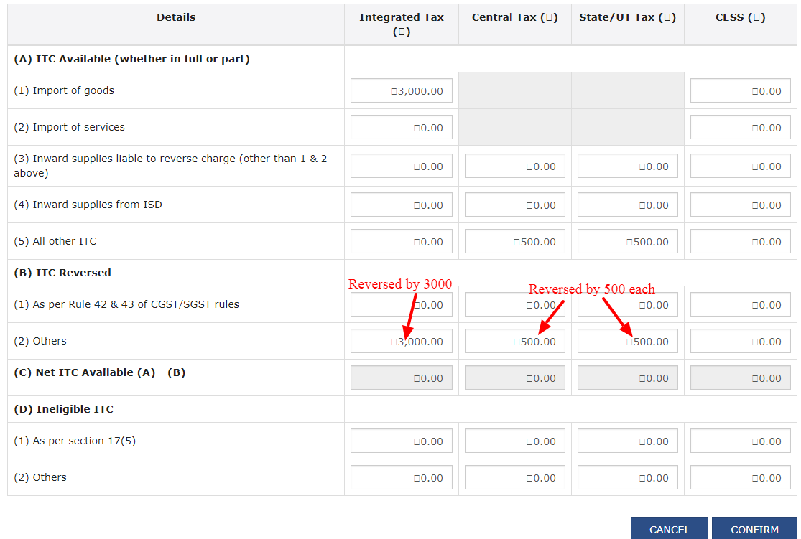
Scenario-9
Available and Reversed in subsequent month i.e. May’ 2018
Balance taxes will be added to liability & payable through electronic cash Ledger with Interest
May'18 Actual | 3000
Add -Apr'18 | 3000
May'18 Reported | 0
May'18 Actual | 500 | 500
Add -Apr'18 | 500 | 500
May'18 Reported | 0 | 0
www.gstindia.biz
67

Slide 68
Scenario-10 : Under-reported ITC in GSTR 3B
Company X has filed their return for the month of Apr’18, after the return the company realise that ITC was not taken in GSTR 3B. What can they do?
In this case
Company will availed ITC in subsequent month i.e. May’18.
ITC should be adjusted against respective head i.e. CGST only against CGST.
If import ITC was not taken in GSTR 3B of a month it should be taken in subsequent month to avoid possible mismatch with bill of entry on ICEGATE portal.
www.gstindia.biz
68

Slide 69
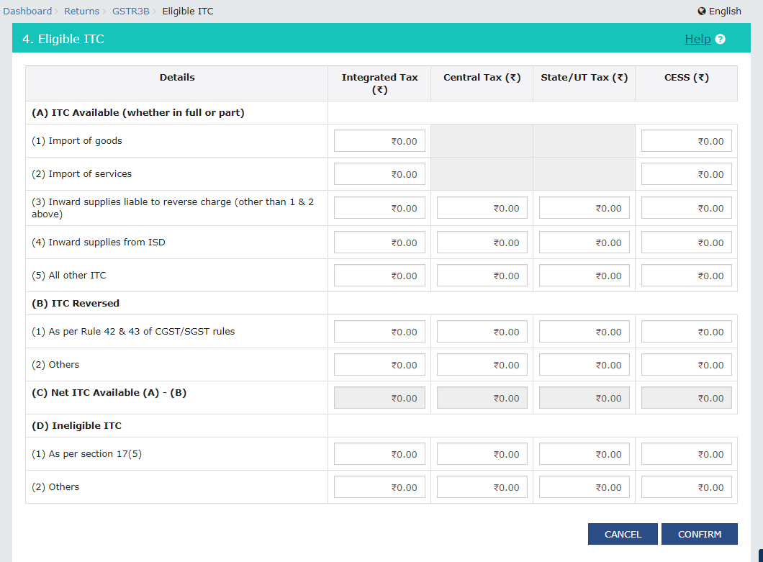
Reported – Apr’ 2018
Scenario-10
www.gstindia.biz
69

Slide 70
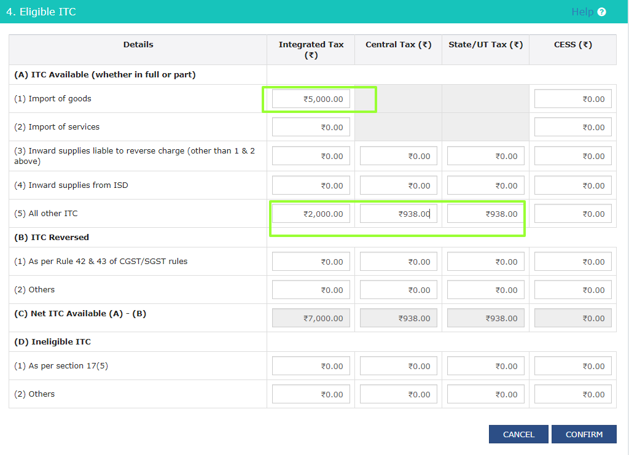
Actual – Apr’ 2018 and to be claimed in May’ 2018
Scenario-10
www.gstindia.biz
70

Slide 71
Correction of errors
Is March 2018 was last return for correction of errors for 2017-18?
CASE STUDY
A Company has filed Form GSTR - 3B and discharged liability from Jul 2017 to March 2018.
The company has not claimed input tax credit (ITC) during the year although such credits can be seen in Form 2A.
Now Can the eligible input tax credit of previous FY be set off against tax liability in the month of April 2018 or onwards and till when , and if yes, how to report the same in Form GSTR - 3B what all other steps are required?
www.gstindia.biz
71

Slide 72
Presentaion of Input Tax Credit in Financial Statement:
Capital & Liabilities
Capital
Total Assets
Cash and Balances with Reserve Bank of India
Reserves & Surplus
Deposits
Borrowings
Other liabilities and provisions
Balances with banks and money at call and short notice
Investments 8 Advances
Fixed Assets
Other Assets
www.gstindia.biz
72

Slide 73
Year End Adjustment
Taxable service provided in the month of say March 25,2018, however the invoice for the same has been issued to the party in the month of April 05, 2018.
Provision for Expenses like Audit Fees
Section 31 of CGST Act for issuance of Tax Invoice;
31(1) An invoice for supply of goods needs to be issued before or at the time of removal of goods for supply to the recipient, where the supply involves movement of goods. However,in other cases, an invoice needs to be issued before or at the time of delivery of goods or while making goods available to the recipient.
31(2) Similarly an invoice for supply of services needs to be issued before or after the provision of service but not later than thirty days from the date of provision of service
GST liablity arises on the basis of invoice,receipt or provision of services.
www.gstindia.biz
73

Slide 74
No liability for excise duty on manufactured inventory as on 30 June 2017
Notification 12/2017 – Central Excise (effective 1 July 2017) exempts all excisable goods (except petroleum crude, high speed diesel, petrol, natural gas, aviation turbine fuel, tobacco and tobacco products) from the whole of excise duty leviable thereon under the Central Excise Act, subject to the following conditions:
The goods should have been manufactured on or before 30 June 2017 but not cleared from the factory of production 1 July 2017;
The appropriate CGST, SGST, UTGST or IGST, as the case maybe, shall be payable on such goods, if cleared on or after the 1 July 2017 as leviable on such goods under the respective acts.
Need to take precaution for free supply.
www.gstindia.biz
74

Slide 75
Case Study for Cash Basis Accounting
www.gstindia.biz
75

Slide 76
Possible Accounting Entries for Cash Basis Accounts
1st Apr, 2018 : Inter-State Services provided of Rs. 1,00,000/- and Tax Invoice raised for Rs. 1,18,000/- (1,00,000+18,000)
20th May, 2018 : Tax paid
F.Y. 2018-19 : Invoice raised but no income recognized
5th May, 2019 : Money received and income recognized in F.Y. 2019-20
Relevant Ledgers Created
IGST Receivable A/c (Current Asset)
IGST Output A/c (Current Liability)
Electronic Cash IGST A/c (Current Assets)
IGST Liability Register A/c (Current Liability)
Professional Fee A/c (Direct Income)
Party A/c (Memorandum Voucher)
Income accrued but not received (Memorandum Voucher)
www.gstindia.biz
76

Slide 77
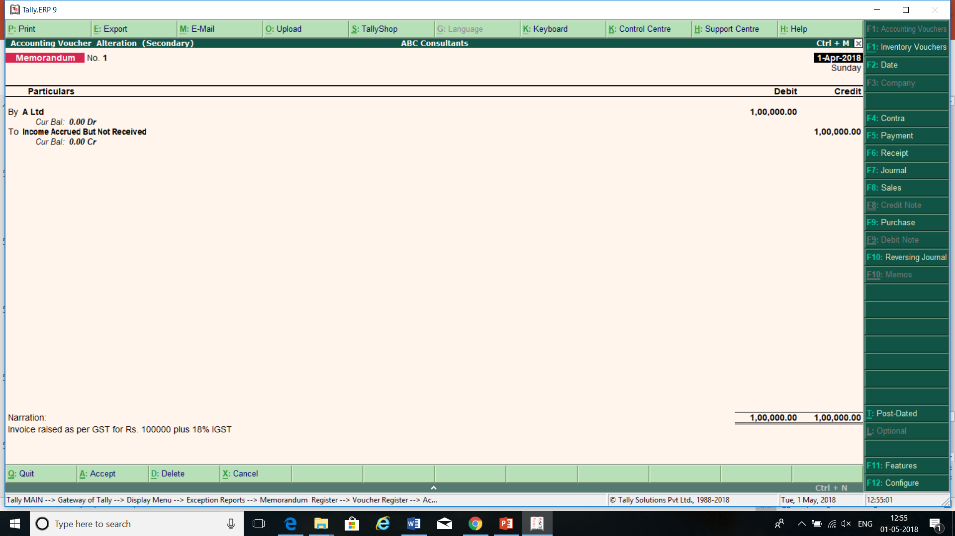
Memorandum entry at the time of raising invoice for service value excluding GST
www.gstindia.biz
77

Slide 78
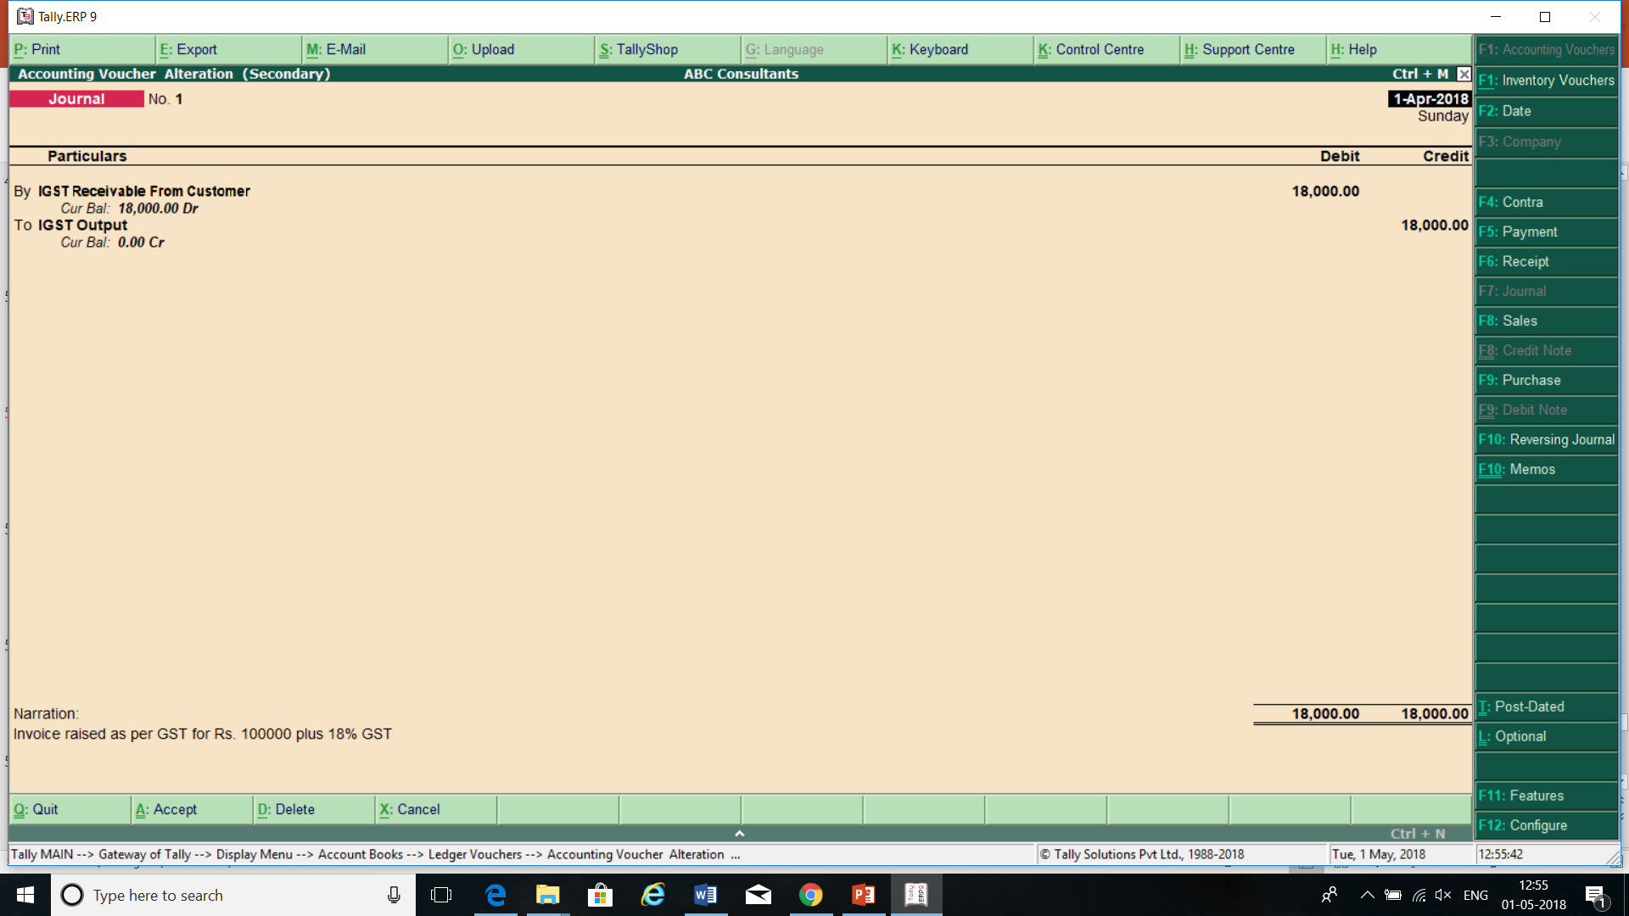
Creating Current Assets for IGST amount to be paid and recoverable from customer.
IGST receivable from customer a/c is Balance Sheet item and will appear as Receivable.
www.gstindia.biz
78

Slide 79

Transfer entry
www.gstindia.biz
79

Slide 80

Tax payment
www.gstindia.biz
80

Slide 81

Tax paid and adjusted
www.gstindia.biz
81

Slide 82
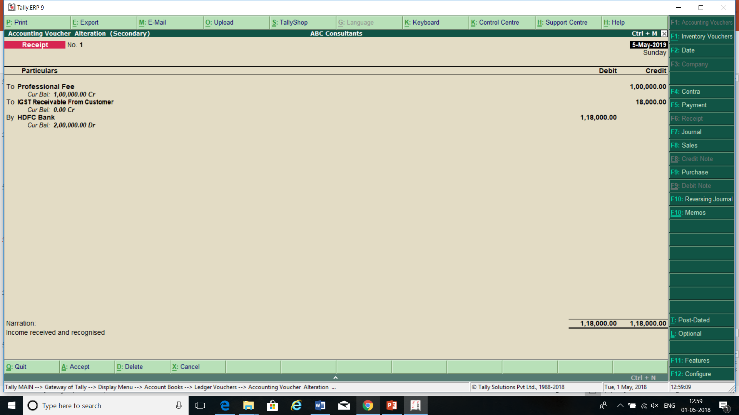
Income recognized at the time of actual receipt
www.gstindia.biz
82

Slide 83
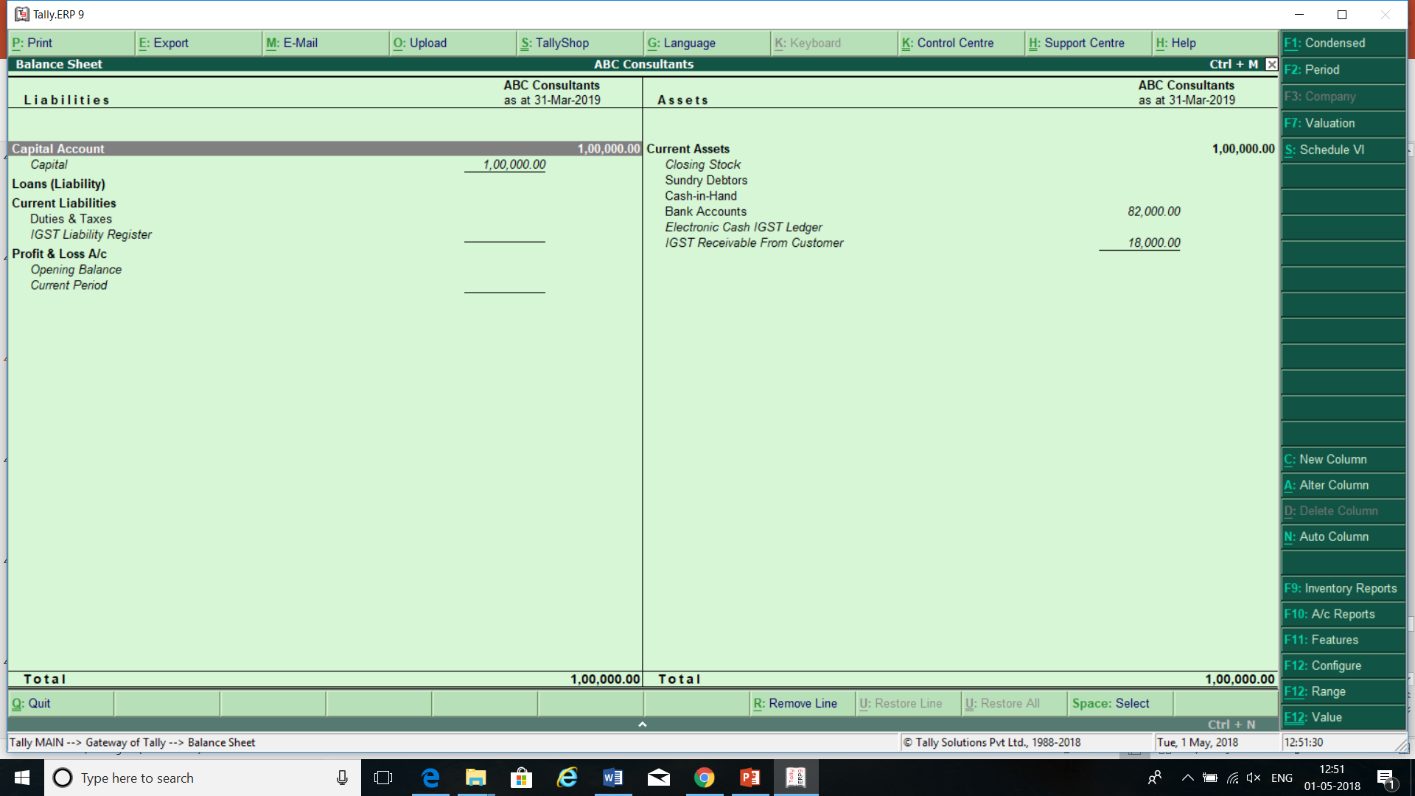
www.gstindia.biz
83

Slide 84
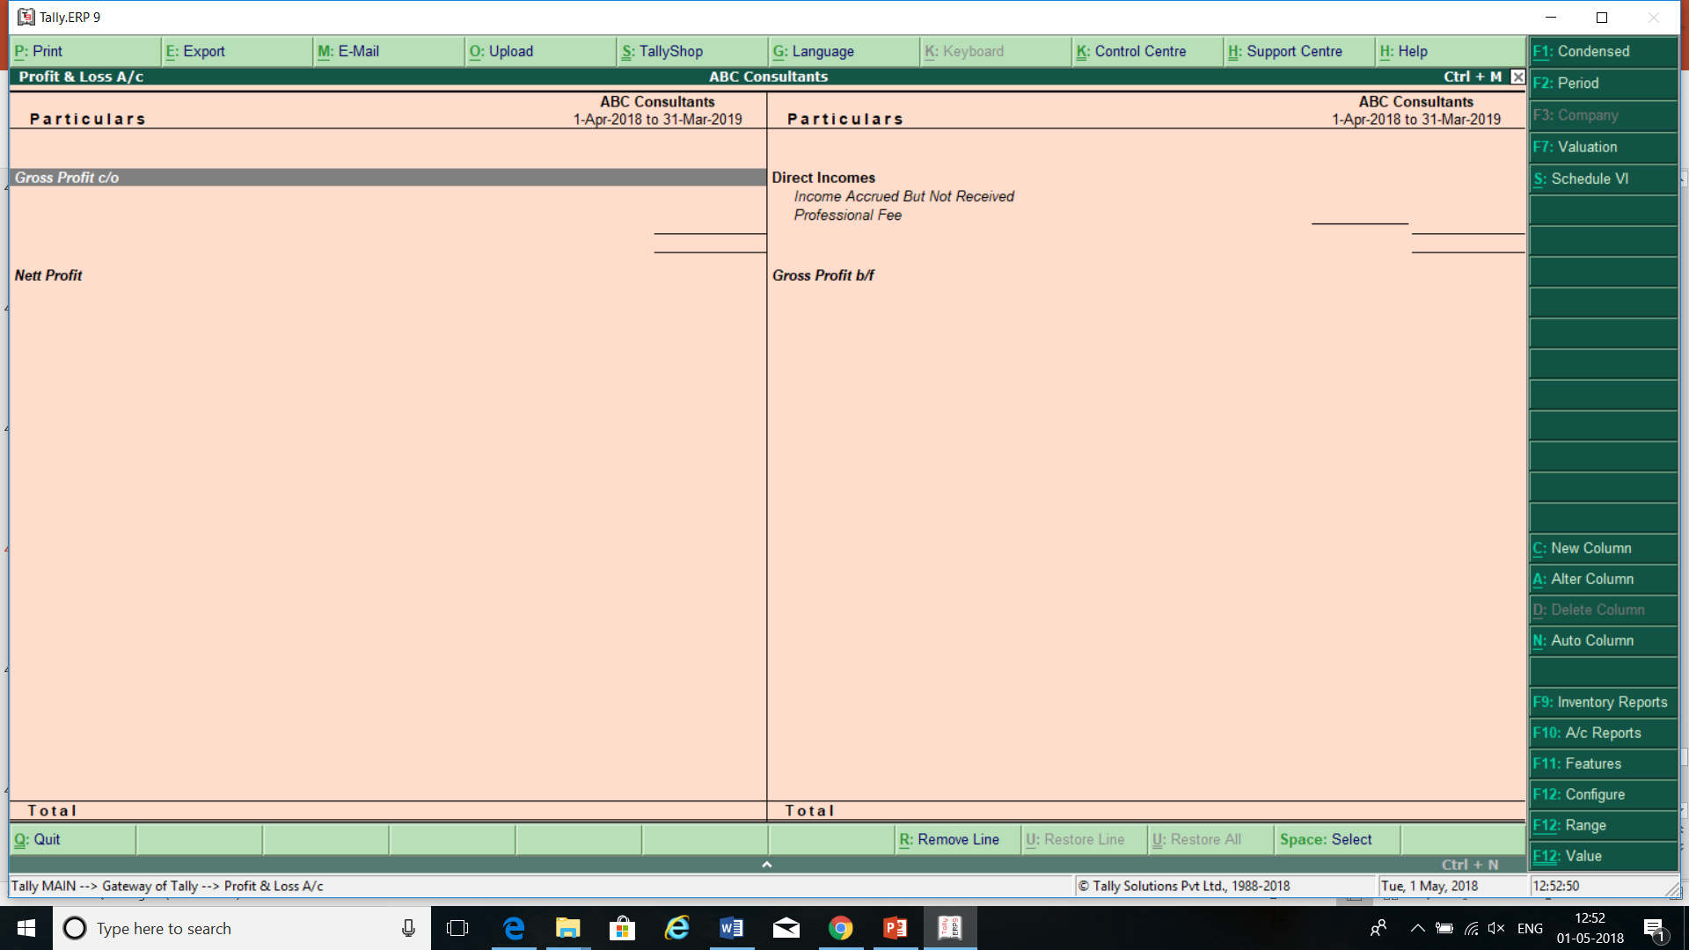
www.gstindia.biz
84

Slide 85

www.gstindia.biz
85

Slide 86

www.gstindia.biz
86

Slide 87
STOCK TRANSFER OF SERVICES
ISD
CROSS CHARGE
www.gstindia.biz
87

Slide 88
Cross Charge
Sec.2(61) of CGST Act defines Input Service Distributor
“Input Service Distributor” means an office of the supplier of goods or services or both which receives tax invoices issued under section 31 towards the receipt of input services and issues a prescribed document for the purposes of distributing the credit of central tax, State tax, integrated tax or Union territory tax paid on the said services to a supplier of taxable goods or services or both having the same Permanent Account Number as that of the said office.
ISD will be applicable when:
Services are received directly by the respective branch/unit
Tax invoice is Received by Centarlise office.
www.gstindia.biz
88

Slide 89
ISD &
Recipient in
Different States
Credit of IGST
IGST
Credit of SGST
IGST
Credit of CGST
IGST
www.gstindia.biz
89

Slide 90
ISD & Recipient
in Same State
(Business vertical)
Credit of IGST
IGST
Credit of SGST
SGST
Credit of CGST
CGST
www.gstindia.biz
90

Slide 91
Cross Charge Vs ISD
Cross charge-where HO/corporate office provides services to another unit/branch or vice versa or from one unit provides services to another unit.
Credit to be distruted through ISD where one office (like HO/Corporate) procurs certain services,common for all/some of its branches.
GST law provides mechanism to distribute credit through ISD mechanism.
In case of cross charge issues will be:
Valuation
What to cross charge?
www.gstindia.biz
91

Slide 92
Diiferent Scenario
Common Services received by the HO and other units.
Services by Employee/Management like CEO,CFO to all units.
Services by one unit to another unit or HO to units.
www.gstindia.biz
92

Slide 93
Reconciliation
Outward Supply and out put tax
Inward supply and Input Tax
Tax payable and Tax payments
www.gstindia.biz
93

Slide 94
Accounting Standards/Accounting Policies
IND AS or AS
Revenue Recogniton-AS -9/IND AS 18
Cost of Inventory-AS-2/IND AS-2
Provisions AS- 29/ IND AS-37
Financial Statements- IND AS-32
Governemnet Grant AS-12/IND AS-20
www.gstindia.biz
94

Slide 95
Revenue Recognition AS and GST
Under Ind AS, revenue from sale of goods is recognised when the significant risks and rewards of ownership is transferred to the buyer and there is no effective control over goods.
Under GST Time of Supply provisions determine the time to pay GST. Earliest of the following dates is time of Supply of Goods:
• Date of issue of invoice by the supplier. If the invoice is not issued, then the last date on which the supplier is legally bound to issue the invoice with respect to the supply , an invoice for supply of goods needs to be issued before or at the time of removal of goods.
• Date on which the supplier receives the payment
Thus raising an invoice at the time of dispatch of goods would give rise to GST liability, it may not lead to revenue recognition in the books of account if the risks and rewards of the goods sold are not transferred to the buyer.
www.gstindia.biz
95

Slide 96
Revenue Recognition IND AS and GST- Deferment of Revenue
revenue recognition may be deferred if the revenue recognition criteria are not met for example,
Under IND AS when the selling price of a product includes an identifiable amount for subsequent servicing, that amount is deferred and recognised as revenue over the period during which the service is performed.For example in case of customer loyalty arrangements where every sale may entitle the buyer for certain loyalty points/credits, which in turn can then be redeemed by the buyer for free services/ products in future. Accordingly, in such situations some portion of the revenue from each sale would be deferred and would be recognised as revenue when the free services/products are delivered in future.
However, for GST purposes transaction invoice value would be the basis of charge without any consideration to the accounting revenue.
www.gstindia.biz
96

Slide 97
Supply without Consideration:
Cases | Revenue Recognition as per AS-9 | Supply as per GST
Branch Transfer | No | Yes
Supply by principal to agent, agent undertakes to supply on behalf of principal | No | Yes
Supply by agent to principal, agent undertakes to receive on behalf of principal | No | Yes
Permanent transfer of business asset without consideration, gift to an employee > Rs. 50,000/- | No | Yes
www.gstindia.biz
97

Slide 98
Goods Sent on Approval:
As per AS-9
Revenue should not be recognized until the goods have been formally accepted or time for rejection has elapsed or where no time has been fixed, a reasonable time has elapsed.
As per GST
Invoice will be issued after 6 months from the date of removal or date of acceptance whicheve is earlier.
www.gstindia.biz
98

Slide 99
Delivery Subject to Inspection/Installation:
As per
AS-9
Revenue should not be recognized until the customer accepts delivery and installation and inspection are complete.
As per
GST
Invoice will be made at the time of removal of goods.
However, when installation process is very simple, revenue should be recognized.
www.gstindia.biz
99

Slide 100
Consignment Sale:
As per AS-9
As per GST
Revenue should not be recognized until the goods are sold to a third party
It will constitute supply on the movement of goods from place of supply
www.gstindia.biz
100

Slide 101
Section 142(11) of CGST Act, 2017
notwithstanding anything contained in section 12, no tax shall be payable on goods under this Act to the extent the tax was leviable on the said goods under the Value Added Tax Act of the State;
notwithstanding anything contained in section 13, no tax shall be payable on services under this Act to the extent the tax was leviable on the said services under Chapter V of the Finance Act, 1994;
where tax was paid on any supply both under the Value Added Tax Act and under Chapter V of the Finance Act, 1994, tax shall be leviable under this Act and the taxable person shall be entitled to take credit of value added tax or service tax paid under the existing law to the extent of supplies made after the appointed day and such credit shall be calculated in such manner as may be prescribed.
www.gstindia.biz
101

Slide 102
Point of Taxation – Service Tax
Point of Taxation Rules provided when the services are provided or agreed to be provided. For this purpose, Rule 2(e) of POTR defines “Point of taxation to mean the point in time when a service shall be deemed to have been provided.”
Further Rule 3 of POTR defines the point of taxation generally as the earlier of the following events:
Date of invoice, if the same is issued within 30 days of completion of service, if not, the date of completion of the service;
Receipt of advance to the extent of such advance or receipt of payment
www.gstindia.biz
102

Slide 103
Applicability of tax on services provided before June 30, 2017
Sl. No. | Completion of service | Invoice date | Payment date | Taxable under
1. | Before June 30, 2017 | Before June 30, 2017 | Before June 30, 2017 | Service Tax
2. | Before June 30, 2017 | Before June 30, 2017 | After June 30, 2017 | Service Tax
3(a). | Before June 30, 2017 | After June 30, 2017 (Invoice raised within 30 days) | After June 30, 2017 | -
3(b). | Before June 30, 2017 | After June 30, 2017 (Invoice raised beyond 30 days) | After June 30, 2017 | Service Tax
4. | After June 30, 2017 | After June 30, 2017 | After June 30, 2017 | GST
www.gstindia.biz
103

Slide 104
Specified Records as per GST law
True & Correct Account of -
Sec. 35(1)
Production or manufacture of goods
Inward & outward supply of goods or services
Rule 56(1)
Goods or services imported
Stock of goods
ITC Availed
Output tax payable and paid
Goods or services exported
Reverse Charge Supplies
Rule 56(3)
Advances received
Advance Paid & adjustments made
www.gstindia.biz
104

Slide 105
Specified Records as per GST law
Inward/ Outward Supplies
Import, Export & Reverse Charge Supplies
Details of Advances
Relevant Documents
Details of Suppliers & Customers
Details of Premises
Stock of Goods Received & Supplied
Tax Payable, Collected, Paid, ITC
Details by Agent
Details of Manufacturing Goods
Details of Supplying Services
Details of Works Contract
Owner/ Operator of Godown or W/h & Transporters
www.gstindia.biz
105

Slide 106
Specified Records as per GST law
Rule 56(2) - Account of stock of goods received and supplied containing:
Opening balance,
Receipt,
Rule 56(4) - Account containing the details of:
Tax payable
Tax collected and paid
Goods lost, stolen, destroyed, written off or disposed of by way of gift or free sample
Input tax
Input tax credit claimed
Together with a register of tax invoice, credit notes, debit notes, delivery challan issued or received
Supply
Balance of stock including raw materials, finished goods, scrap and wastage thereof
www.gstindia.biz
106

Slide 107
Financial Statements
On Consolidated basis not separate for each Registration
Basis for preperation is AS /Ind AS/Compnay Law
www.gstindia.biz
107

Slide 108
Few more pointers:
2017-18 to be seen in two parts : 1st April 2017 to 30th June 2017 and 1st July 2017 to 31st March,2018.
Transitional entries to be reviewed properly, especially carry forward of earlier balances, Stock with job workers, Stock lying with branches, continuing contracts etc
Old liabilities: No pending balance should remain in Balance sheet
Opening advances from customers and to vendors :to be examined for credits
Anti profiteering – Examination necessary.
Related party Transactions
Reporting requirements in ITR and Tax Audit forms from GST perspective.
Review of promotional schemes
GST Audit
www.gstindia.biz
108

Slide 109




ashu.dalmia@ada.org.in
+91-11-22466591, 45665691, 22422707
+91-9810893243
https://www.gstindia.biz/
www.gstindia.biz
109

