Slide 1
E way Bill –Law and Challenges
Hello !
6th April 2018
Ashu Dalmia

Slide 2
WHY E WAY BILL
Website: http://gstindia.biz

Slide 3
SECTION 68 –CGST ACT
The Government may require the person in charge of a conveyance carrying any consignment of goods of value exceeding such amount as may be specified to carry with him such documents and such devices as may be prescribed.
The details of documents required to be carried under sub-section (1) shall be validated in such manner as may be prescribed.
Where any conveyance referred to in sub-section (1) is intercepted by the proper officer at any place, he may require the person in charge of the said conveyance to produce the documents prescribed under the said sub-section and devices for verification, and the said person shall be liable to produce the documents and devices and also allow the inspection of goods.
Website: http://gstindia.biz

Slide 4
SECTION 164 –CGST ACT
The Government may, on the recommendations of the Council, by notification, make rules for carrying out the provisions of this Act.
Notification 12/2018 dated 7th March,2018-Amending Rule 138 to 138D
Notification 14/2018 dated 23rd March,2018-Adding Explanation after Rule 138D
Notification 15/2018 dated 23rd March,2018-Effective date of applicability of Eway bill Rules except Clause 138(7)
Website: http://gstindia.biz

Slide 5
Applicability-Eway Bill
Website: http://gstindia.biz

Slide 6
Notification 12/2018 dated 7th March,2018-Amending Rule 138 to 138D
Rule | Particular
Rule 138 | Information to be furnished prior to commencement of movement of goods and generation of e-way bill
Rule 138A | Documents and Devices to be carried by a person-in-charge of a conveyance
Rule 138B | Verification of Documents and Conveyance
Rule 138C | Inspection and Verification of Goods
Rule 138D | Facility of uploading information regarding detention of vehicles
Website: http://gstindia.biz

Slide 7
What Documents and devices to be carried by a person-in-charge of a conveyance ?-Rule 138A
A copy of the E-way bill or E-way bill number, either physically or mapped to a Radio Frequency Identification Device embedded on the conveyance.
The Invoice or Bill of Supply Or Delivery Challan or Invoice reference no. generated from www.gst.gov.in
However Commissioner may by notification require following documents instead of e-way bill:
Tax Invoice/Bill of Supply/Bill of Entry/Delivery Challan
Website: http://gstindia.biz

Slide 8
Verification of Documents and Conveyance-Rule 138B
Verfication through Installed RFID
By Proper officer
Authorised by:
Commissioner
Or
Officer empowered by Commissioner
Website: http://gstindia.biz

Slide 9
Inspection and Verification of Goods-Rule 138C & Rule 138D
Part A of GST EWB 03-online within 24 hrs of inspection
Part B of GST EWB 03-with in 3 days of inspection
GST EWB-04-by transporter in case vehicle is intercepted and detained for more than 30 minutes
Where the physical verification of goods being transported on any conveyance has been done during transit at one place within the State or Union territory or in any other State or Union territory, no further physical verification of the said conveyance shall be carried out again in the State or Union territory, unless a specific information relating to evasion of tax is made available subsequently
Website: http://gstindia.biz

Slide 10
Consequences of not carrying documents as per Rule 138A
Section 122
Section 129
This is penalty of Rs. 10000/- or amount equivalent, whichever is higher
Penalty equivalent to amount of tax sought to be evaded in addition to detention or seizure of goods and conveyance as per Section 130
-Confiscation of the goods
-Penalty u/s 122
-Fine upto market value of goods confiscated
Section 130
Website: http://gstindia.biz

Slide 11
Section 129-CGST ACT
shall be released,––
on payment of the applicable tax and penalty equal to one hundred per cent. of the tax payable on such goods and, in case of exempted goods, on payment of an amount equal to two per cent. of the value of goods or twenty-five thousand rupees, whichever is less, where the owner of the goods comes forward for payment of such tax and penalty;
(b) on payment of the applicable tax and penalty equal to the fifty per cent. of the value of the goods reduced by the tax amount paid thereon and, in case of exempted goods, on payment of an amount equal to five per cent. of the value of goods or twenty-five thousand rupees, whichever is less, where the owner of the goods does not come forward for payment of such tax and penalty;
(c) upon furnishing a security equivalent to the amount payable under clause (a) or clause (b) in such form and manner as may be prescribed:
Website: http://gstindia.biz

Slide 12
Section 129-CGST ACT
129(2):The provisions of sub-section (6) of section 67 shall, mutatis mutandis, apply for detention and seizure of goods and conveyances.
Website: http://gstindia.biz

Slide 13
Section 129-CGST ACT
(6) Where the person transporting any goods or the owner of the goods fails to pay the amount of tax and penalty as provided in sub-section (1) within seven days of such detention or seizure, further proceedings shall be initiated in accordance with the provisions of section 130:
Website: http://gstindia.biz

Slide 14
Bond and security for release of seized goods Section 67(6) and Rule 140
Section 67 (6):The goods so seized under sub-section (2) shall be released, on a provisional basis, upon execution of a bond and furnishing of a security, in such manner and of such quantum, respectively, as may be prescribed or on payment of applicable tax, interest and penalty payable, as the case may be.
Rule 140:-(1) The seized goods may be released on a provisional basis upon execution of a bond for the value of the goods in FORM GST INS-04 and furnishing of a security in the form of a bank guarantee equivalent to the amount of applicable tax, interest and penalty payable. Explanation.- For the purposes of the rules under the provisions of this Chapter, the “applicable tax” shall include central tax and State tax or central tax and the Union territory tax, as the case may be and the cess, if any, payable under the Goods and Services Tax (Compensation to States) Act, 2017 (15 of 2017).
(2) In case the person to whom the goods were released provisionally fails to produce the goods at the appointed date and place indicated by the proper officer, the security shall be encashed and adjusted against the tax, interest and penalty and fine, if any, payable in respect of such goods.
Website: http://gstindia.biz

Slide 15
SECTION 130 Applicability
130. (1) Notwithstanding anything contained in this Act, if any person—
supplies or receives any goods in contravention of any of the provisions of this Act or the rules made thereunder with intent to evade payment of tax; or
does not account for any goods on which he is liable to pay tax under this Act; or
supplies any goods liable to tax under this Act without having applied for registration; or
(iv) contravenes any of the provisions of this Act or the rules made thereunder with intent to evade payment of tax; or
Website: http://gstindia.biz

Slide 16
CASE LAW
Website: http://gstindia.biz

Slide 17
M/S. R.R. AGRO INDUSTRIES THROUGH ITS PROP. vs. STATE OF U.P. THROUGH ITS SECY. AND 3 OTHERS
(Writ Tax No. 105 of 2018, Jan 31, 2018, (2018) 02 CCHGST 0003 AllHC)
Section 20 of the IGST Act provided that provisions of Central G.S.T. Act would apply in respect of matters of inspection, search, seizure and arrest to matters covered by IGST Act, in matter of seizure under provisions of IGST Act provisions of Central G.S.T. Act such as Section 129 would apply mutatis mutandis, in this way power of seizure under the IGST Act read with Central G.S.T. Act is analogues to that under Section 129 of the U.P. G.S.T. Act.
Website: http://gstindia.biz

Slide 18
M/s Indus Towers Limited Versus The Assistant State Tax Officer
W. P. (C) No. 196 of 2018 KERALA HIGH COURT Dated: - 17 January 2018
Combined reading of Sections 129 and 130, especially the provision contained in sub section (6) of Section 129 indicates that the detention of the goods is contemplated under the statutes only when it is suspected that the goods are liable to confiscation. Section 130 dealing with the confiscation of goods indicates beyond doubt that the confiscation of goods is contemplated under the statutes only when a taxable supply is made otherwise than in accordance with the provisions contained in the statutes and the Rules made there under with the intent to evade payment of tax. If that be so, mere infraction of the procedural Rules like Rules 55 and 138 of the State GST Rules cannot result in detention of goods, though they may result in imposition of penalty.
Website: http://gstindia.biz

Slide 19

REQUIREMENTS
OF E-WAY BILL
Website: http://gstindia.biz

Slide 20
PART A EWB-01
By Whom | Condition | Rule
Registered Person | Consignment Value >50K | 138(1)
Transportor | Consignment Value >50K | First Proviso to rule 138(1)
E commerce Operator | Consignment Value >50K | Second Proviso to rule 138(1)
Courier Agency | Consignment Value >50K | Second Proviso to rule 138(1)
Principal or Job Worker | Any Value | Third Proviso to rule 138(1)
Any Person | Handicraft Goods-Any Value | Fourth Proviso to rule 138(1)
Website: http://gstindia.biz

Slide 21
PART B EWB-01
By Whom | Condition | Rule
Person Doing Movement-Consignor,consignee | By road -Own Coveyance or hired | 138(2)
Supplier or Reciepeint before or after commencement of movement | Movement by Rail,air or Vessel. | 138 (2A)
Transportor | In case PART B is not filled by Supplier/Receipient or movement done by unregistered person | 138(3) & Second Proviso of 138 (3)
UnRegistered Peron | Casuing Movement | Second Proviso to rule 138(1)
Website: http://gstindia.biz

Slide 22
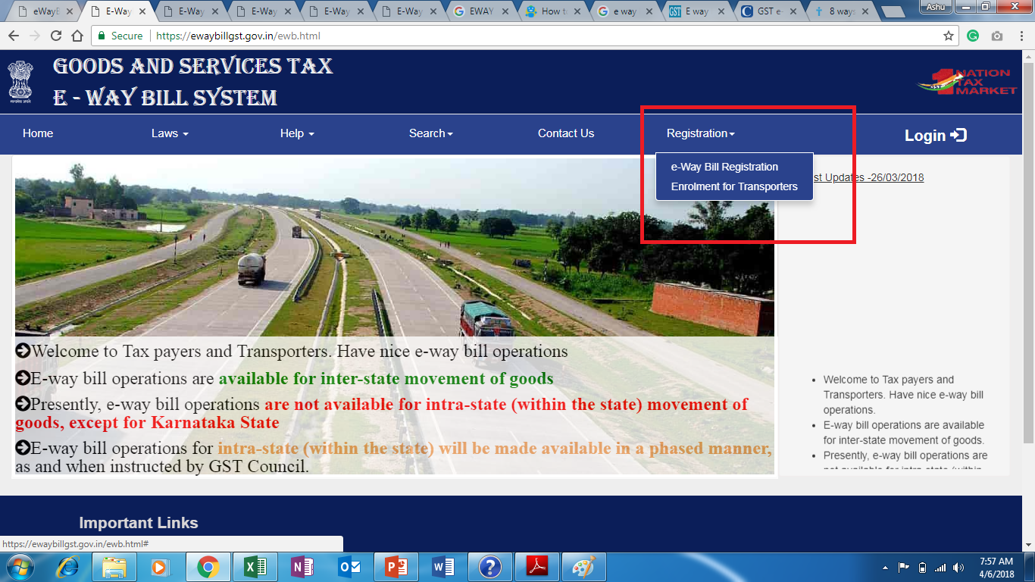
No option for Unregistered Person
Website: http://gstindia.biz

Slide 23
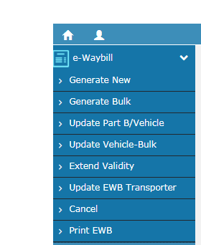
After Login
Website: http://gstindia.biz

Slide 24
All fields are not mandatory
Website: http://gstindia.biz

Slide 25
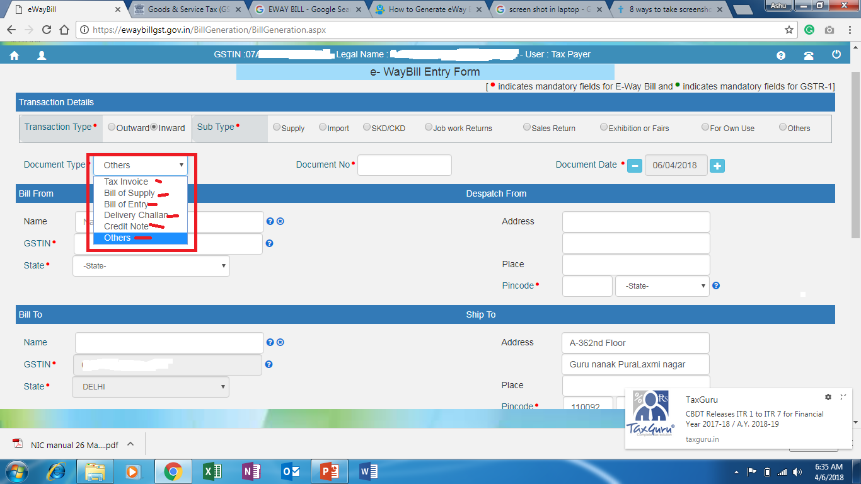
Website: http://gstindia.biz

Slide 26
Outward
FROM address-auto-populated
To address-To be entered
Inward
FROM address-To be entered
To address- auto populated
Website: http://gstindia.biz

Slide 27
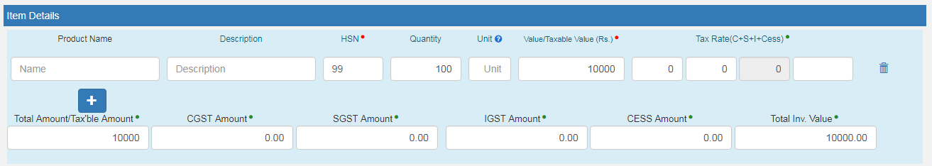
Item Details
Website: http://gstindia.biz

Slide 28
Transportar details
Website: http://gstindia.biz

Slide 29
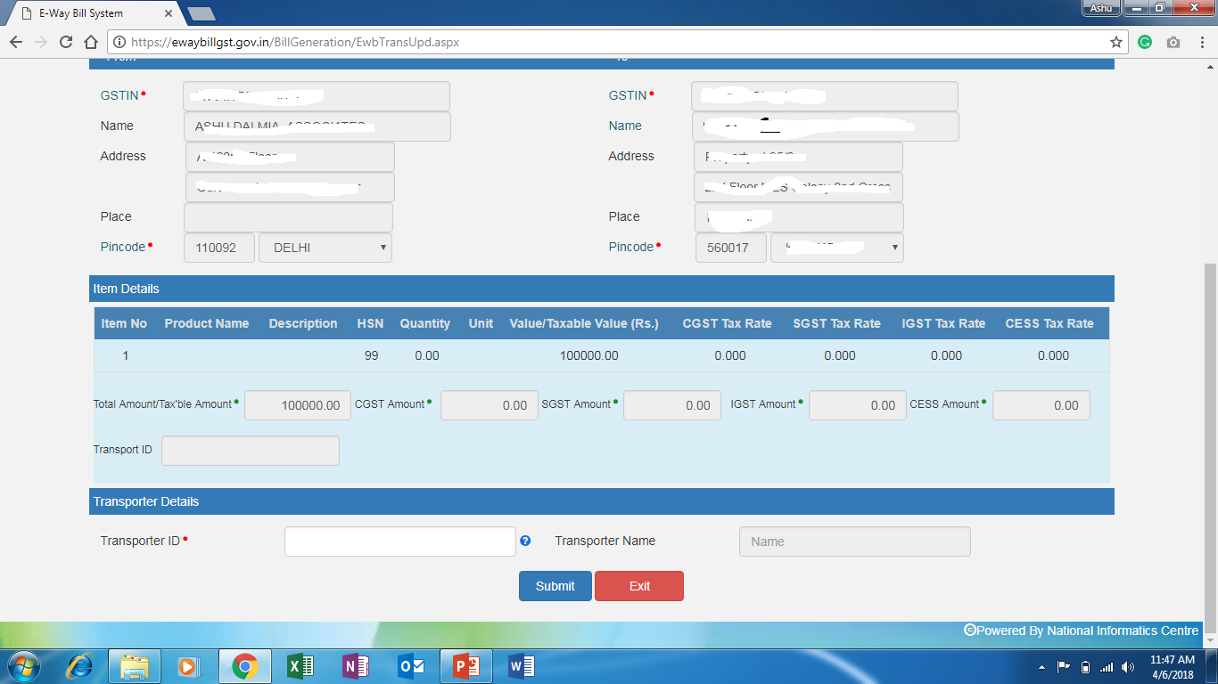
Updation of transportaor details in PART A
Website: http://gstindia.biz

Slide 30
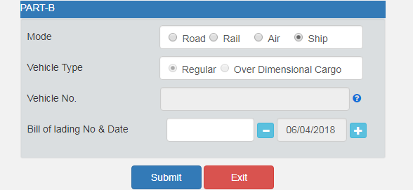
Part B
Website: http://gstindia.biz

Slide 31
Cancellation of E way Bill
Where an e-way bill has been generated, but goods are either not transported or are not transported as per the details furnished in the e-way bill, the e-way bill may be cancelled electronically on the common portal within 24 hours of generation.
Where the person to whom the information specified in sub-rule (11) has been made available does not communicate his acceptance or rejection within 72 hours of the details being made available to him, it shall be deemed that he has accepted the said details.
The E-Way bill can’t be cancel, after verification in-transit.
Unique no generated will be valid for a period of 15 days for updating of Part B of Form GST EWB01
Website: http://gstindia.biz

Slide 32
Validity of E way Bill
SR. No. | DISTANCE | VAIDITY PERIOD
1. | Upto 100 km | One Day in case other than over dimensional cargo
2, | For every 100 km or part thereof thereafter | One Additional Day in case other than over dimensional cargo
3. | Upto 20 km | One Day for over dimensional cargo
4. | For every 20 km or part thereof | One Additional Day for over dimensional cargo
Website: http://gstindia.biz

Slide 33
Validity of E Way Bill
Period of validity shall be counted from the time at which the E-Way bill has been generated and each day shall be counted as the period expiring at midnight of the day next to generation of E-way bill.
Validity period can be extended:
1.Through notification for certain category of goods
2.After uploading details in Part B of EWB-01 by transporter in exceptional circumstances including trans-shipment.
Over dimensional cargo shall mean a cargo carried as a single indivisible unit and which exceeds the dimensional limit prescribed in Rule 93 of the central motor vehicles rules 1989.
Website: http://gstindia.biz

Slide 34
EXCEPTION
Website: http://gstindia.biz

Slide 35
For Movement to transporter up to 50 Kms
Where the goods are transported for a distance of up to fifty kilometers within the State or Union territory from the place of business of the consignor to the place of business of the transporter for further transportation, the supplier or the recipient, or as the case may be, the transporter may not furnish the details of conveyance in Part B of FORM GST EWB-01.
Website: http://gstindia.biz

Slide 36
Items specified in Annexure to Rule 138(14)(a)
S.No | Description of Goods
1 | Liquefied petroleum gas for supply to household and non domestic exempted category (NDEC) customers
2 | Kerosene oil sold under PDS
3 | Postal baggage transported by Department of Posts
4 | Natural or cultured pearls and precious or semi-precious stones; precious metals and metals clad with precious metal (Chapter 71)
5 | Jewellery, goldsmiths’ and silversmiths’ wares and other articles (Chapter 71)
6 | Currency
7 | Used personal and household effects
8 | Coral, unworked (0508) and worked coral (9601)
Website: http://gstindia.biz

Slide 37
Other Exceptions
In respect of movement of goods within such areas as are notified under rule 138(14) of the SGST rules,2017 of the concerned state.
Goods being transported are alcoholic liquor for human consumption petroleum crude, high speed diesel, motor spirit natural gas, or aviation turbine fuel.
Where empty cargo containers are being transported.
Goods exempt from tax under
Notification NO. 7/2017
and
Notification NO. 26/2017 Central tax (rate)
Where Goods being transported by non-motorized vehicle.
Website: http://gstindia.biz

Slide 38
Goods transported are transit cargo from or to Nepal or Bhutan..
Goods specified in the schedule appended to notification No. 2/2017 Central tax (rate) other than de oiled cake.
Where supply of goods is treated as no supply under Schedule 3 of the Act.
Consignor of goods is the Central Government, Government of any state or local authority for transport of goods by rail.
Goods being transported from the port, airport , air cargo complex and land customs station to an inland container depot or a container freight station for clearance by customs.
Website: http://gstindia.biz

Slide 39
Where the goods being transported upto distance of 20km from the place of business to a weighbridge for weighment or from the weighbridge back to the place of business of the said consignor subject to the condition that the movement of goods is accompanied by delivery challan issued in accordance with rule 55.
Where goods are being transported
(i)under customs bond from an inland container depot or a container frieght station to a customs port ,airport , air cargo complex and land customs station, or from one custom station or port to another custom station or port, or
(ii) Under custom supervision or under custom seal.
Movement of goods caused by defence formation under Ministry of defence as a consignor or consignee.
Website: http://gstindia.biz

Slide 40
Thanks

